Slide 1
State of Kuwait Scholastic Year 2022/2023
Ministry of Education Private Education
E.L.T Supervision Second Term
Professional Development Program
Teaching Writing
Mr. Mamdouh El-Sheikh
Mrs.Wafaa Aljeraiwi
ELT Acting Senior Supervisor:

Slide 2
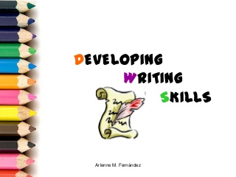
Teaching writing

Slide 3
Expected Outcomes
At the end of this workshop, teachers should be able to:
Recognize the process of teaching writing.
Discover some useful techniques when teaching writing.

Slide 4


What is writing?

Slide 5
Writing is a process of conveying our thought in a written form. It can be a book, a story, a letter, a novel and so on. Writing is a way of expressing ideas.
"Writing is a way of talking without being interrupted.”

Slide 6

Why is writing important?

Slide 7
We need to write because:
1. Writing is an Essential Communication Skill
2. Creative Writing Engages Both Sides of the Brain
3. It Helps You Think Through Problems
4. Written Word Influences Society
5. We Wouldn’t Have Our History Without Writing
6. You’re More Likely to Achieve Written Goals

Slide 8
To be a successful writer in English, you need to learn:
The writing style of the English language
The words of the language
The grammar of the English language

Slide 9

Writing in English:
Different languages use different writing styles of organization. English is fairly simple. English speakers expect to read an article that has a beginning, a middle and an end. The beginning should say what the article is about, the middle talks about the details of the topic and the end tells what the topic was about.

Slide 10
This is what I will write about
I am writing about it here
This is what I wrote about

Slide 11

Basic academic writing in English is linear in structure that has…
Beginning
Topic sentence
Middle
The body which is made up of sequence of sentences. They are called supporting sentences.
End
A concluding sentence that ends the paragraph by reminding the reader of the main point of the paragraph.

Slide 12
What is a paragraph?
The basic unit of academic writing in English.
All other types of academic writing, such as essays, reports, compositions and research papers are based on the paragraph.

Slide 13
Writing a paragraph
A paragraph develops ONE main idea through a series of related sentences.
This main idea is usually introduced in the first sentence of the paragraph, called the topic sentence. The idea is then developed further through the sentences that follow.
A paragraph has a topic sentence, supporting details, and a concluding sentence.

Slide 14
What is a topic sentence?
It contains the main idea of the paragraph. It has two main parts.
Topic :
It has the subject of the paragraph.
Controlling idea :
It limits the topic of the paragraph and shows an aspect of the topic that needs to be explored.

Slide 15
The Characteristics of a good topic sentence

Slide 16
The topic sentence should aim at persuading the reader of the writer’s point of view.
It should have a clear point of view, which is the writer’s opinion.
A statement of fact is not an effective topic sentence because there is nothing more that can be said about it
Look at these two sentences: Which one of them can be a good topic sentence and why?
International Women’s Day is on March 8th.
( Fact )
International Women’s Day is important for many reasons.
( Opinion )

Slide 17
Task ( 1 )
Read the following sentences to identify the topic and the controlling ideas, and decide if it is a good topic sentence and why?
Going to a big holiday party is like a punishment to me.
Independence Day is a holiday in any country.
There are many reasons to stay at home on holidays.
It’s important to honor your mother on Mother’s Day.
Rain can ruin a picnic.

Slide 18
Holiday party (Topic) / A punishment to me (opinion)
Independence Day (Topic) / A holiday in any country (fact)
Staying at home on holidays (Topic)/There are many reasons (opinion)
Honoring your mother (Topic) / It’s important (opinion)
Rain (Topic) / Ruin a picnic (Opinion)

Slide 19
Task ( 2 )
From our the intermediate English textbooks, formulate good topic sentences.

Slide 20



Kuwait lies on the Arabian Gulf.
Kuwait is a wonderful country.

Slide 21
The Body Paragraph

Slide 22
It contains the supporting sentences that explain the topic sentence.
To do support the topic sentence, there are many ways:
Facts
Examples
Illustrations based on personal experience

Slide 23
Major & Minor supporting sentences:
In terms of organization, especially of expository paragraphs, there are two types of supporting sentences:
Major
Minor

Slide 24
Golden Week in Japan is a celebration of four holidays. The first takes place on April 29th, the birthday of the Emperor Showa , and commemorates the 64 years that he was in power. It is a time for the Japanese people to remember this important period in their history.

Slide 25
Topic Sentence:
Golden Week in Japan is a celebration of four holidays.
Major supporting sentence
The first takes place on April 29th, the birthday of the Emperor Showa , and commemorates the 64 years that he was in power.
Minor supporting sentence:
It is a time for the Japanese people to remember this important period in their history.

Slide 26
Examples from the intermediate books

Slide 27
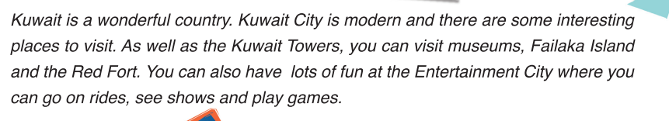
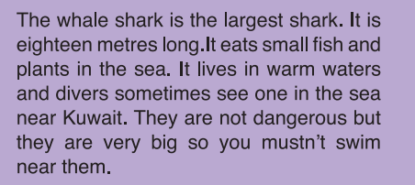
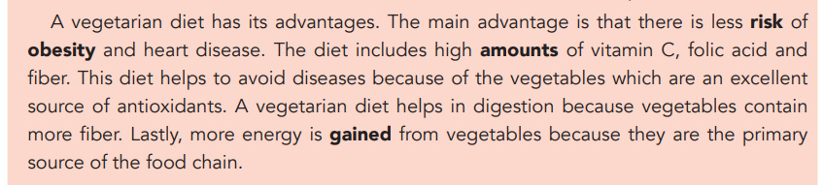

Slide 28
The Topic sentence (TS)
………………………………………………
The Major supporting sentence(SS)
……………………………………………….
The minor supporting Sentence(ss)
………………………………………………..

Slide 29
The Concluding Sentence

Slide 30
The concluding sentence
Usually, a concluding sentence is a restatement of the topic sentence.
It gives the same information as the topic sentence, but expressed in a different way.
Concluding sentences usually start with a transition word.
Less common way to conclude a paragraph is to write a sentence that summarizes the main points in the body of the paragraph.

Slide 31
Paragraph Format
What are the rules for paragraph format?

Slide 32
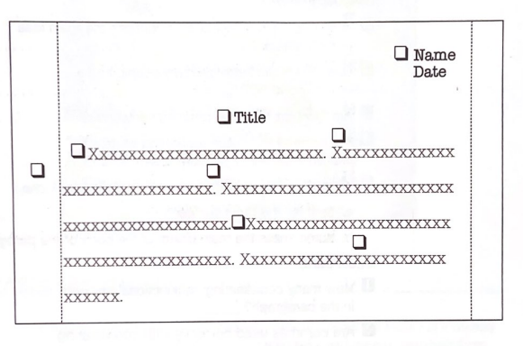

Slide 33
Paragraph Format
1. Put your name and the date in the upper righthand corner.
2. Center your title on the next line.
3. Indent the first sentence by using the tab key or by going in five spaces to the right.
4. Start each sentence with a capital letter.
5. End each sentence with a period, a question mark, or an exclamation point.
6. Begin each sentence where the previous sentence ends.
7. Write on every other line. This is called double-spacing.
8. Put margins of about one inch on each side of the paper.

Slide 34
Task 3:
Based on your experience, what are the
steps you follow when teaching writing?

Slide 35
Modeled Writing:
After collecting data from students, it’s very important to show them how to transfer the suggested ideas into a paragraph by giving them a sample such as:
“Last night, I was so happy. I couldn’t imagine that I would meet my best friend after a long absence. We started talking about our memories at schools. Then, he invited me to his house where he showed me some pictures about our past time. After that, we decided to fix another date to spend more time together. Finally, I went back home so proud of our friendship.”
*Students have to read the paragraph and put a line under the main idea and two lines under the supporting details.
*They have to justify the use of the past tense and circle all the verbs in the paragraph.
*They have to justify the utility of punctuation when writing a paragraph.

Slide 36
Another main approach is “The Writing Process”.
Writing as a process involves:
Thought-showering or ‘brainstorming’ notes, ideas, words and phrases about a topic.
Categorising and ordering the ideas according to the task requirements.
Writing a first draft.
Revising the first draft by improving content and accuracy.
Implementing the improvements in the re-written text.

Slide 37
The Writing Process:
3. Organising your ideas.
Write the topic sentence
Eliminate ideas
Make an outline and add ideas.
1. Analyzing the assignment.
2.brainstorming.
4. Writing the first draft.
5.Rewriting the first draft.
Revise
edit
6.Writing the next (or final) draft.

Slide 38
1. Analyzing the assignment.
The first step is be sure that your students understand the assignment so that they can give you what is asked for.
“Write a well-organized paragraph giving advice to a person who wants to learn a foreign language. Use your own knowledge. Please submit your paragraph by noon on Monday. I will only accept typed paper.”
(N.B) the students ask themselves the following questions: what, why, where, how long, When and how.

Slide 39
1. Analyzing the assignment.
Answer (For the assignment) | question
Advice for learning a foreign language. | Is the topic? | What
To show my ability to organize a concept. | Am I writing? | Why
From what I already know | Do I get the information? | Where
One paragraph | Is the paper? | How long
Monday at noon | Is the due? | When
typed | Do I present it? | how

Slide 40
2. Brainstorming:
To ‘brainstorm’ means to write down ideas of all kinds – good or bad- on a piece of paper. Don’t evaluate the ideas at this stage because in brainstorming, all ideas are equal. You will evaluate at the next stage.
Using mind map
Start with a circle in the middle of a piece of paper. Write the topic of the assignment inside the circle. Then start ideas you associate with the topic around the circle. You can use lines to point to the various ideas, you can use arrows to show that ideas are related, or you can put related ideas in smaller circles. In other words, there is no right or wrong way.

Slide 41
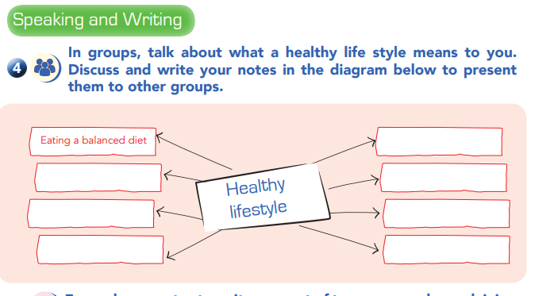

Slide 42
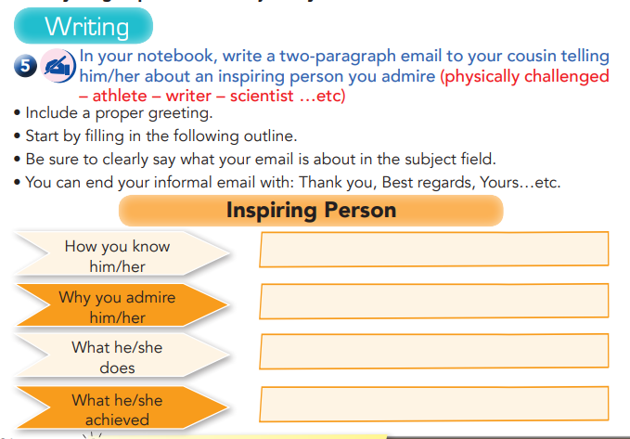

Notes:
Examples grade 9 module 1 Unit 2. Grade 5 Unit 1 lesson 8

Slide 43
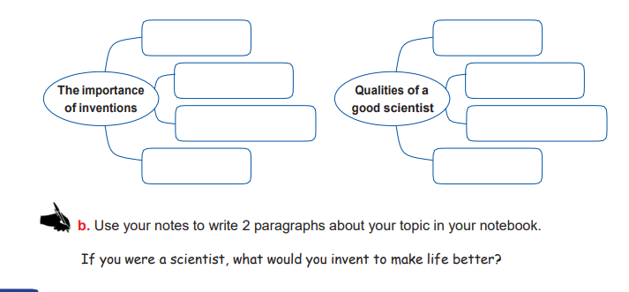

Slide 44
An Assignment
“What was (or is) your favourite subject in high school? What made it your favourite? Please type your paragraph and submit it as an attachment to an
e-mail by midnight on Sunday.”

Slide 45
Color in summer
Fresh air
No air conditioning
Away from hot classroom
Ugly uniform
Blue shorts
Pink shirts
Get outside
Feel healthy and look good
Favourite class
PE
Made some friends
Run laps – out of sight
Ok to listen to MP3 player
Some friends didn’t have MP3
Chat with friends while running
Nice PE teacher
Kind, friendly
Year before- too difficult.

Slide 46
Using column
To use this technique, fold a piece of paper lengthwise in two, three or four to create two, three or four columns. Write the general topic, favorite class at the top of paper. Then write a key word – of any kind- at the top of each column. Now start writing down all kind of words that come to mind under the heading of each column.

Slide 47
Favourite Class – Physical Education
example
Always hot in classroom
Chance to chat with friends
Kind
friendly
details
No AC
Meet some friends
Nicer than history
Teacher
Let us use MP3
Nobody looked good in them
Strong muscles
Can do more things
Learned more sports
Reasons
Get out of classroom
Could choose to run laps
PE teacher

Slide 48
Free writing
Start with a word or a phrase and write down anything you think of that is related to the topic. Instead of listing a lot of points, try to write complete sentences. When you get stuck, just start writing more about one of the previous words and continue writing about that. Don’t worry about grammar, punctuation or spelling because no one else will see your freewriting. The most important aspect of free writing is to not allow yourself to stop. Just let your ideas and imagination flow. Here is an example of a free writing exercise about the topic “favorite high school subject.”

Slide 49
Free writing
Favorite subject- lots! I enjoyed many of my classes. But, well, PE was my favorite. I got out of the hot classroom. I was always so hot! No AC in our school, summers were awful. Also- best thing was running laps. No one could see us. We could pull out our mp3 and listen to music and run around. But those uniforms- so ugly! Pink and blue! Got stronger because of PE classes. At the end of the year, I could see my muscles! Also, I learned some new sports. Ok, the best thing about the HS was the PE.

Slide 50
3. Organising your ideas:
You will probably find that you can write many different paragraphs from the ideas in your brainstorming. Now you need to organize your ideas. Step 3 has three stages:
Write your topic sentence.
Eliminate irrelevant ideas.
Make an outline and add relevant ideas.

Slide 51
4. Writing the first draft:
Now you are ready to turn the ideas in your outline into complete sentences and write the sentences in good paragraph format. This draft of your paragraph is just for you, so again don’t worry about grammar or punctuation. Here is the first draft of the paragraph about the student’s favorite class.

Slide 52
My favorite high school class was phys ed for a lot of reasons. My school was in city, and it was always hot in summer. We never had air conditioning. Secondly, we were aloud to run laps instead of other things. So we ran around where no one could see us. And the PE teacher was so nice! Encouraging, too. We played our MP3s and chatted while we were running. It was great. Next I felt healthier and stronger- even slept better! My PE class was a wonderful part of high school.

Slide 53
5. Rewriting the first draft:
The next step is to rewrite your paragraph. Rewriting consists of two parts: Revising and Editing.

Slide 54
Revising
When you revise a paragraph, you check the organization of your paragraph and look at your ideas. Ask yourself questions like these:
Does the paragraph have unity.
Are there enough minor supporting ideas for the major supporting sentences?
Do the supporting sentences have good coherence?
Is there good cohesion?

Slide 55

Coherence
A paragraph has coherence when the supporting sentences are ordered according to a principle. The sentences are put in order so that the reader can understand your ideas easily.
The principles for ordering depend on the type of paragraph you are writing.
There are three main types of paragraphs:
* Narrative paragraphs * Descriptive Paragraphs
* Expository paragraphs

Slide 56
How can we achieve coherence in each type of a paragraph?

Slide 57
Cohesion:
Lexical cohesion:
it can be realized by “repetition of words & lexical sets”
Grammatical cohesion:
it can be achieved through:
Pronoun and possessive reference:
Tense agreement:
using a relative tense makes the text cohesive
Linkers:
words that explain the text relationships of “addition, contrast, giving examples, comparing, …etc”

Slide 58
Editing
When you edit a paragraph, look at the grammar, spelling, word forms and punctuation. Since many of your editing mistakes may be eliminated when you revise the paragraph. You should always edit your writing after you revise it.
Look again at the first draft of the paragraph, note the points for revision and editing that the writer has made. Can you think of any others?

Slide 59
Need little
Physical education
My favorite high school class was phys ed for a lot of reasons. My school was in city, and it was always hot in summer. We never had air conditioning. Secondly, we were aloud to run laps instead of other things. So we ran around where no one could see us. And the PE teacher was so nice! Encouraging, too. We played our MP3s and chatted while we were running. It was great. Next I felt healthier and stronger- even slept better! My PE class was a wonderful part of high school.
Not clear reason
Add transition
therefore
Add other reason?
Not complete sentence
Move to second point
In short,

Slide 60
6. Writing the final paper (or next draft):
The last step in the writing process is writing a clean version of the paragraph with all the revisions and editing carried out. This draft is the one that you will turn in, so be sure that you use good paragraph format.
Here is the final draft of the paragraph:

Slide 61
Physical Education
My favourite high school class was physical education for a lot of reasons. First of all, My school was in city, and it was always too hot in the classroom. Going outside to the fresh air was such a relief. Secondly, we were aloud to run laps instead of lifting weight or playing basketball. Therefore, we ran around where no one could see us. We could listen to our MP3s and chat with friends as long we were running. Moreover, the PE teacher was great. He was so kind and encouraging. I needed that. Finally, I felt so much healthier and even started to sleep better. In short, my PE class was a wonderful part of high school for me.

Slide 62


