Slide 1
State of Kuwait Scholastic Year 2022/2023
Ministry of Education Private Education
E.L.T Supervision Second Term
Professional Development Program
How to design a good test
Part 1
By ELT Supervisor: Mrs. Owida Jaber Alsaadi
ELT Acting Senior Supervisor: Mrs.Wafaa Aljeraiwi

Slide 2
What is a Test?
.
It is an evaluation through which teachers measure learners’ abilities and points of weaknesses and strengths. It gauges their knowledge in the field of study and provides both sides with real feedback.

Slide 3
What is a Test?
.
A test is a crucial part of education, no matter the subject or level. We usually think of tests only as tools to measure how much a student has learned, though with the right post-exam data, they can be so much more, including tests themselves being a learning tool.

Slide 4
Why do we test learners?
To make an educational decision
To measure students' language proficiency
To determine students' strength & weakness
To monitor and follow the progress of students
To See the effectiveness of the teaching methods used

Slide 5
Good test questions:
assess what you intend for them to assess
allow students to demonstrate what they have learned
elicit answers that reveal students’ intellectual progress
motivate students and help them structure their academic efforts
can discriminate between students who have learned what you had intended them to learn and those who have not

Slide 6
What kind of tests do we have according to tests’ questions ?
1-Subjective Tests:
These tests take the form of writing sentences, paragraphs or essays. In subjective tests, it usually happens that different scores to the same question.
Answers to subjective questions often involve persuasive/defensible argument or present various options for in-depth discernment. Test items like these usually come in the form of long answers, essays, or performance-based evaluations.
2-Objective Tests:
The grading of these tests is independent of the person marking the tests because these tests have definite answers, which have no room for subjectivity in grading.
Objective test items have a clear correct answer; item types include multiple choice, true/false, short answer, and fill-in-the-blank items.

Slide 7
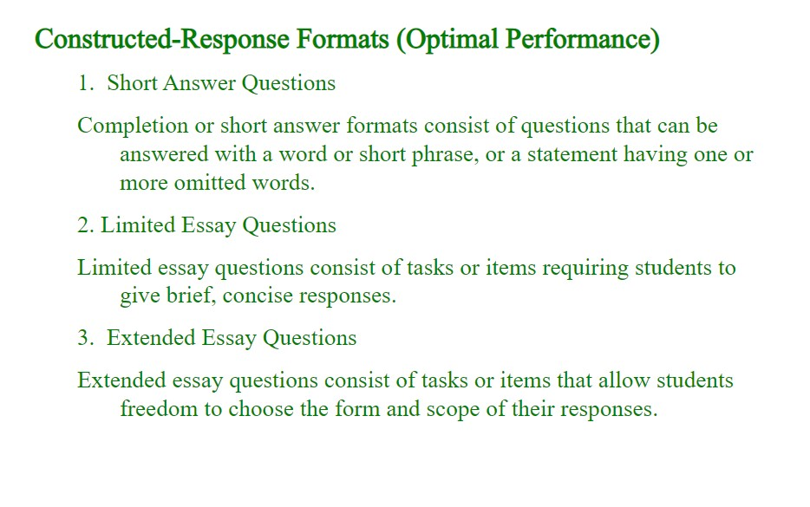

Slide 8
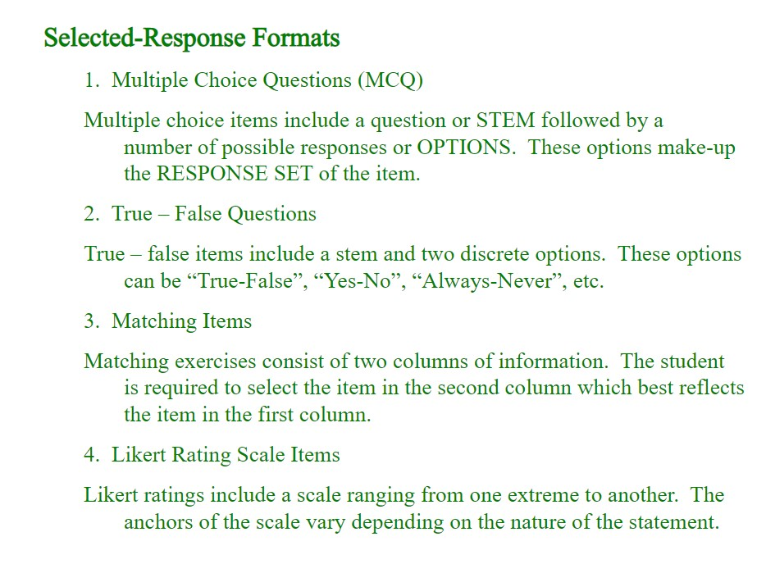

Slide 9
What Are the Qualities of Good Assessment?
In order for a test to be a good tool for measuring students’ knowledge and skills, it should have the following characteristics of examination that are essential for the success of any test.

Slide 10
The Qualities of Good Assessment
Consistency. Students should achieve similar if the exam were taken again.
Validity. Your questions need to relate to your course content and your learning goals
Realistic expectations. Not all students have the ability to answer the hardest questions all the time. Your exams should have a variety of questions that test multiple skill levels.
Time bound Your students should have plenty of time to complete the exam.
Uses multiple question types. Different students are better at different types of questions. In order to allow all students to demonstrate their abilities, exams should include a variety of question types so that students have multiple ways to achieve marks.

Slide 11
The Qualities of Good Assessment
Demanding. Challenge your students with authentic questions that test their skill, but do not make the test too easy.
Easy to understand marking criteria. Have your students received feedback from you on assignments, class discussion, etc., so they know what to expect on the exam? Have you clearly stated to students what is expected of them on the exam?
Provide progressive structure. Your exam should open with some easier questions and progressively get more challenging. There are two reasons for this. It allows students to answer a variety of question types, and also allows them to use the exam to build confidence as they move to more challenging questions.

Slide 12
Comprehensiveness
A test should fully cover the entire field of study that students are exposed to during the course.

Slide 13
Preparation
Students have to be well-prepared for the test through extensive revisions and discussions.
There should not be any gaps between the revision period and the exam.
Examiners should make it clear to students which topics are expected to be tackled in the exam.
Students should be well-trained for the test type.

Slide 14
Applying Bloom Taxonomy for Good Test questions

Slide 15
Bloom’s Taxonomy
Bloom’s Taxonomy provides an important framework for teachers to use to focus on higher order thinking. It can assist teachers in designing performance tasks, and providing feedback on student work. Questions for Critical Thinking can be used in the classroom to develop all levels of thinking within the cognitive domain. The results will improve attention to detail, increase comprehension and expand problem solving skills.

Slide 16
Revised Bloom’s taxonomy (2001)
It helps students work their way through a series of verbs to meet learning objectives.
Below are descriptions of each of the levels in revised Bloom’s Taxonomy:
Remember: To bring an awareness of the concept to learners’ minds.
Understand: To summarize or restate the information in a particular way.
Apply: The ability to use learned material in new and concrete situations.
Analyze: Understanding the underlying structure of knowledge to be able to distinguish between fact and opinion.
Evaluate: Making judgments about the value of ideas, theories, items and materials.
Create: Reorganizing concepts into new structures or patterns through generating, producing or planning.

Slide 17
Revised Bloom’s Taxonomy (2001) question samples:
Remember: Who…? What…? Where…? How…?
Understand: How would you generalize…? How would you express…? What information can you infer from…?
Apply: How would you demonstrate…? How would you present…? Draw a story map.
Analyze: How can you sort the different parts…? What can you infer about…? What ideas validate…? How would you categorize…?
Evaluate: What criteria would you use to assess…? What sources could you use to verify…? What information would you use to prioritize..? What are the possible outcomes for…?
Create: What would happen if…? List the ways you can…? Can you brainstorm a better solution for…?

Slide 18
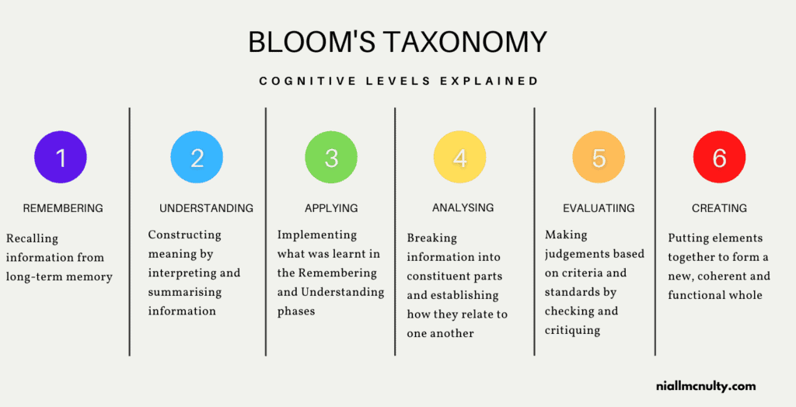

Slide 19
Tips for Writing Good Test Items

Slide 20
Terminology Regarding Multiple-Choice Test Questions
This is the most common objective-type item. The multiple-choice item is a test question which has a number of alternative choices from which the examinee is to select the correct answer.
It is generally recommended that one use 3 or 4 choices per question, whenever possible.
Stem: This is the part of the item in which the problem is stated for the examinee. It can be a question, a set of directions or a statement with an embedded blank.
Options/Alternatives: These are the choices given for the item.
Key: This is the correct choice for the item.
Distractors: These are the incorrect choices for the item.

Slide 21
- The stem (statement) should not be a definition of the word.
-The stem should be meaningful in itself and related to the alternatives.
-Avoid lengthy stems and very short ones as well in all test questions.
-The stem should not be ambiguous; it should not have difficult words that may distract the students.
-The stem (and the alternatives) should be stated clearly and concisely.
Vocabulary:
Multiple Choice and Gap filling

Slide 22
Vocabulary:
Multiple Choice and Gap filling
-Alternatives should be homogeneous in content: parts of speech, length, formatting, and language choice in the alternatives.
-The stem should not hold negative ideas or negative connotations/denotations.
-Avoid complex multiple-choice items.
-should be relevant to what is taught and covers the test area .
-It should have only one answer .

Slide 23
2. Grammar:
-Make sure all alternatives are grammatically parallel.
-All alternatives should be grammatically correct.
Any incorrect alternative should not be included in the test
-Grammar questions should be varied .
-Avoid possible answers.

Slide 24
3.Reading Comprehension:
-The reading passage should have a relatively acceptable level of difficulty and age appropriate.
-The passage should not have complicated or ambiguous sentence formation.
-The questions should have Literal comprehension questions. Literal comprehension refers to an understanding of the straightforward meaning of the text, such as facts, vocabulary, dates, times, and locations.
-Questions of literal comprehension can be answered directly and explicitly from the text.

Slide 25
-There should be reorganization questions. Reorganization is based on a literal understanding of the text; students must use information from various parts of the text and combine them for additional understanding.
-There should be inference questions included. Students may initially have a difficult time answering inference questions because the answers are based on material that is in the text but not explicitly stated.
-An inference involves students combining their literal understanding of the text with their own knowledge and intuitions.
Reading Comprehension:

Slide 26

How can we extract the main idea or decide the best title for a text?
Watch the video and know how can you design them in your exams

Slide 27


Slide 28
4.Writing:
-The topics should be semi-related to the textbook material.
-The number of words (lines) should be indicated clearly.
-The helping ideas provided should be ―helpful not confusing.
-The graphic organizer and out lines should be very related to the topic and indicate the ideas they have.
-Rubrics should be included in the writing test for the students to see how are they going to be assessed.

Slide 29


