Slide 1
State of Kuwait Scholastic Year 2022/2023
Ministry of Education Private Education
E.L.T Supervision Second Term
Professional Development Program
How to design a good test
Part 2
By ELT Supervisor: Mrs. Owida Jaber Alsaadi
ELT Acting Senior Supervisor: Mrs.Wafaa Aljeraiwi

Slide 2

Comment
Ace a test
Bone up on
Burn the candle at both ends

Slide 3
Ace a test = obtain a very high score or an excellent result
Bone up on = study hard, usually in preparation for a test
Burn the candle at both ends = stay up late into the night and then get up early next day to carry on working

Slide 4
Technical Quality of a Test*

Slide 5
1. Cognitive Complexity
Standard: The test questions will focus on appropriate intellectual activity ranging from simple recall of facts to problem solving, critical thinking, and reasoning.

Slide 6
2. Content Quality
Standard: The test questions will permit students to demonstrate their knowledge of challenging and important subject matter.

Slide 7
3. Meaningfulness
Standard: The test questions will be worth students’ time and students will recognize and understand their value. students should not be forced to guess what will be on a test.

Slide 8
4. Language Appropriateness
Standard: The language demands will be clear and appropriate to the assessment tasks and to students.
Test questions should :
Reflect the language that is used in the classroom.
Test items should be stated in simple, clear language,
Free of non-functional material and extraneous clues.
Should also be free of race, ethnic, bad bias and negative concepts.

Slide 9
5. Transfer and Generalizability
Standard: Successful performance on the test will allow valid generalizations about achievement to be made.
Teachers can make valid generalizations about achievement more easily using assessments.
These generalizations may involve instructional placement decisions, formative evaluation decisions and diagnostic decisions.

Slide 10
6. Fairness
Standard: Student performance will be measured in a way that does not give advantage to factors irrelevant to school learning; scoring schemes will be similarly equitable.
Here are a few basic rules of fairness:
test questions should reflect the objectives of the unit;
expectations should be clearly known by the students;
each test item should present a clearly formulated task;
ample time for test completion should be allowed;

Slide 11
7. Reliability
Standard: Answers to test questions will
be consistently trusted to represent what students know.
The whole point of testing is to encourage learning.
A good test is designed with items that are not easily guessed without proper studying.

Slide 12
Tips for Writing Good Test Items

Slide 13
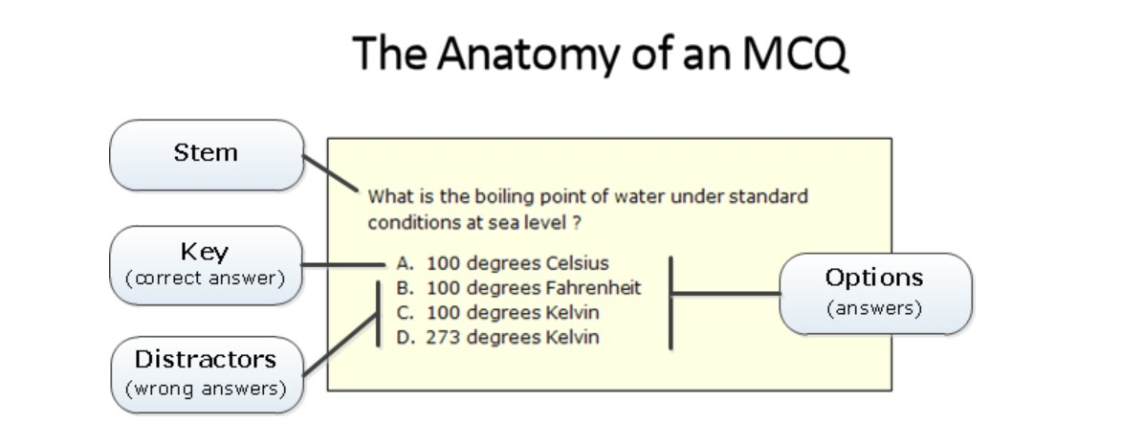
Writing Multiple Choice Test Items

Slide 14
Writing Multiple Choice Test Items
1. When possible, state the stem as a direct question rather than as an incomplete statement.
2. Present a definite, explicit and singular question or problem in the stem.
3. Eliminate excessive verbiage or irrelevant information from the stem.
4.Include in the stem any word(s) that might otherwise be repeated in each alternative.
5. Use negatively stated stems sparingly. When used, underline and/or capitalize the negative word.

Slide 15
6. Make all alternatives plausible and attractive to the less knowledgeable or skillful student.
7. Make the alternatives mutually exclusive.
8. Make alternatives approximately equal in length.

Slide 16
True-False Test Items
1. Express a single idea in each test item.
2. Avoid the use of unfamiliar vocabulary.
3. Avoid using negatively stated item statements.
4. Express the item statement as simply and as clearly as possible.
5. Base true-false items upon statements that are absolutely true or false, without qualifications or exceptions.

Slide 17
Matching Test Items
1. Avoid grammatical or other clues to the correct response.
2. Use only items that share the same foundation of information.
3. The column of stimuli on the left should set the question clearly.
4. Include directions which clearly state the basis for matching the stimuli with the responses.

Slide 18
Completion or Fill-in-the-Blank Test Item
1. Omit only significant words from the statement.
2. Do not omit so many words from the statement that the intended meaning is lost.
3. Avoid obvious clues to the correct response.
4. Be sure there is only one correct response.
5. Avoid grammatical clues to the correct response.
6. If possible, vary where to put the blank either at the end of a statement or at the beginning etc …

Slide 19
Writing
-The topics should be semi-related to the textbook material.
-The number of words (lines) should be indicated clearly.
-The helping ideas provided should be ―helpful not confusing.
-The graphic organizer and out lines should be very related to the topic and indicate the ideas they have.
-Rubrics should be included in the writing test for the students to see how are they going to be assessed.

Slide 20
Samples of questions:
Group Discussion

Slide 21
Vocab. - questions

Slide 22
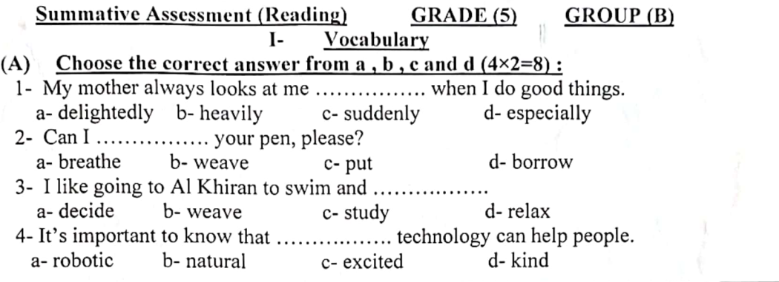

Slide 23
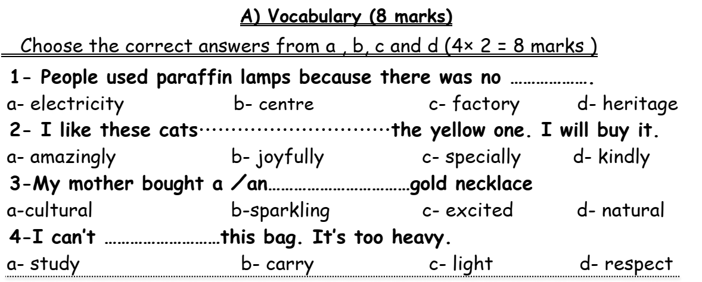

Slide 24
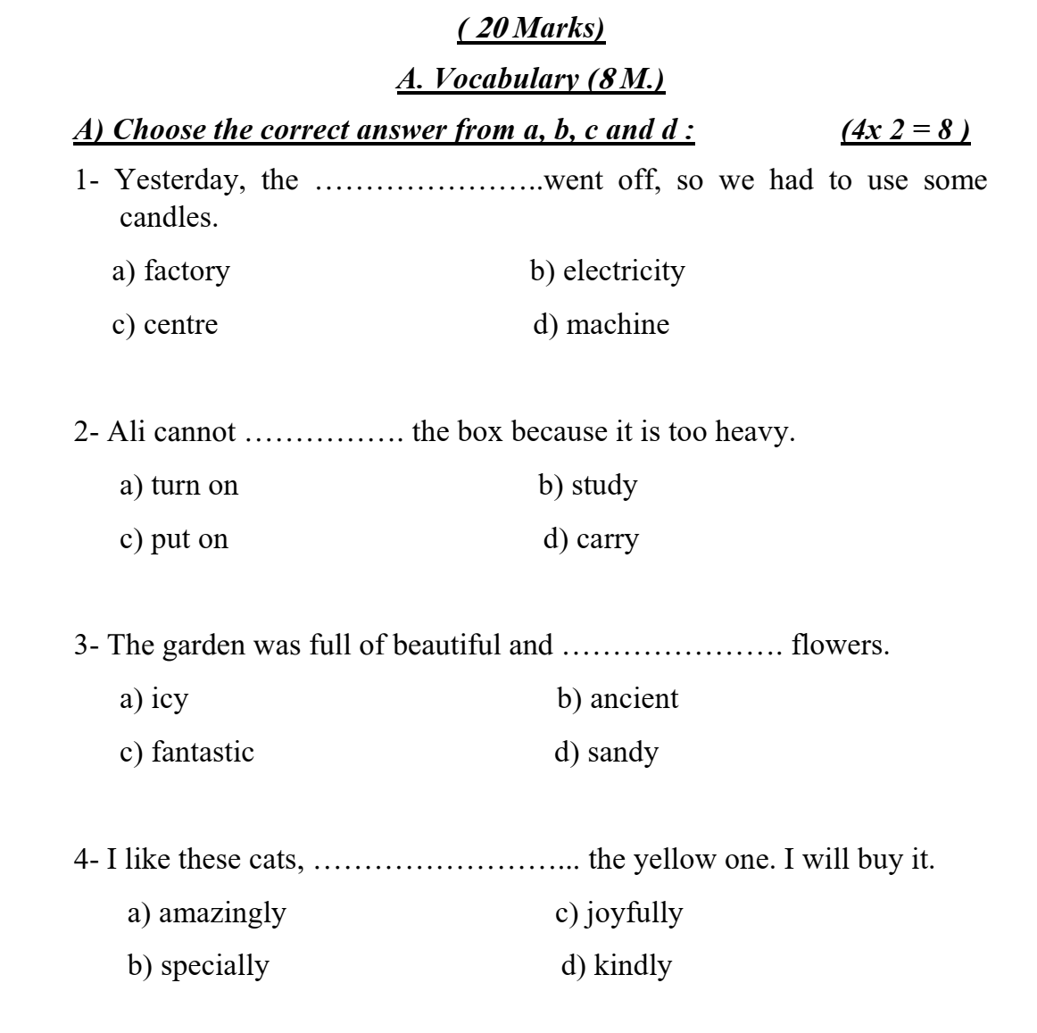

Slide 25
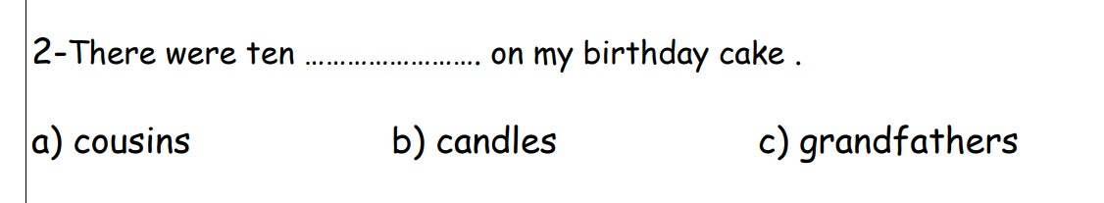
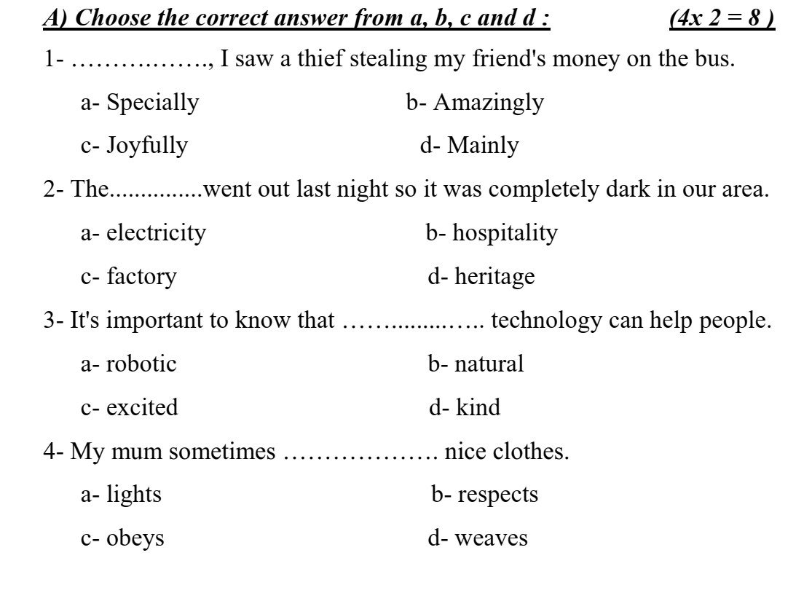

Slide 26
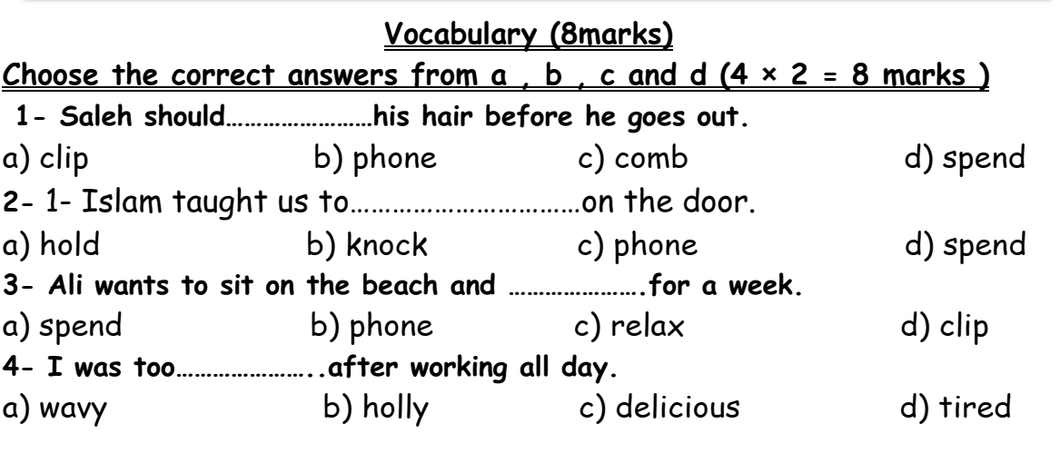

Slide 27
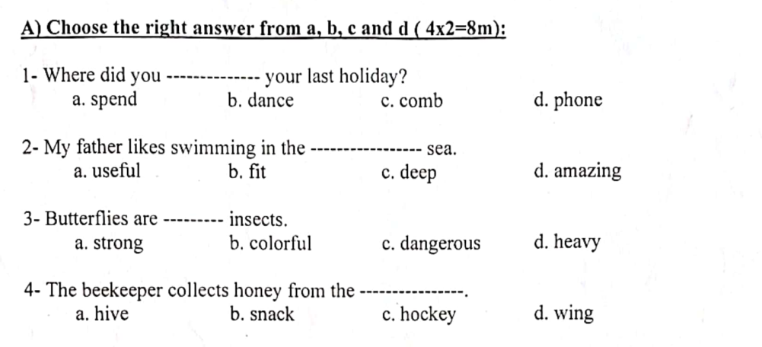

Slide 28
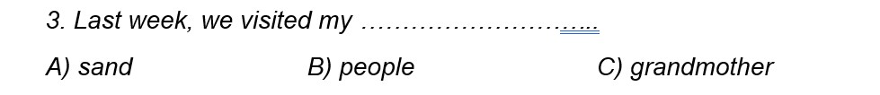
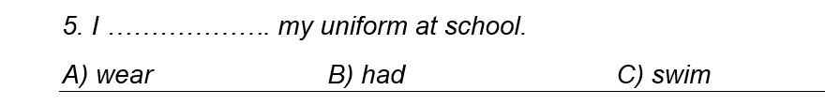

Slide 29
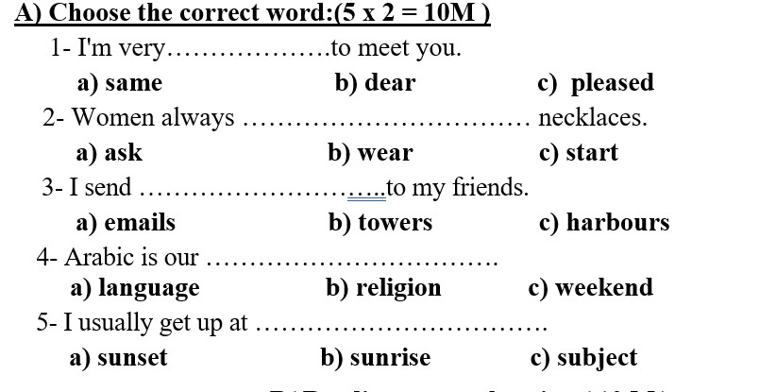

Slide 30
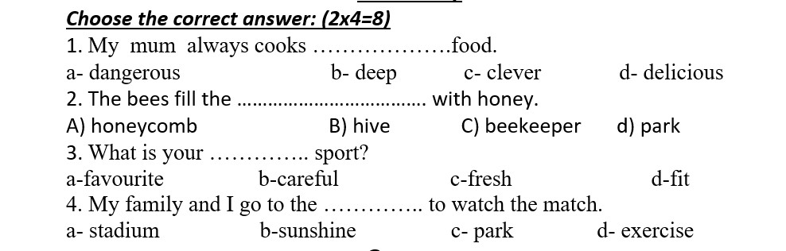

Slide 31
grammar

Slide 32
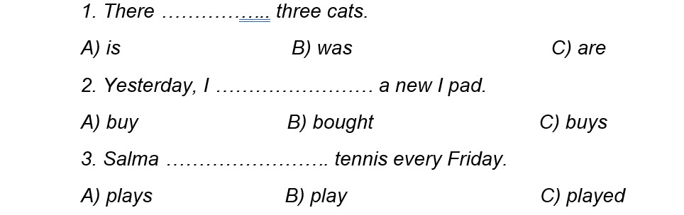
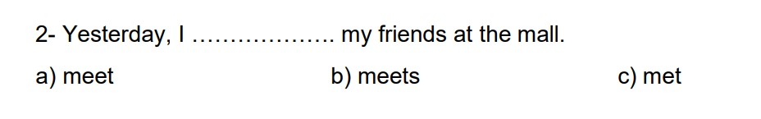

Slide 33
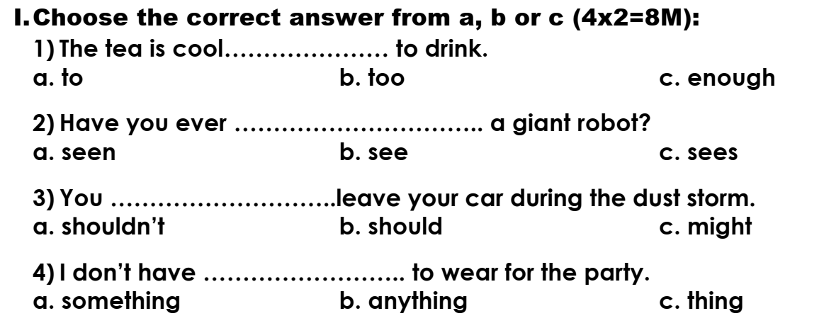

Slide 34
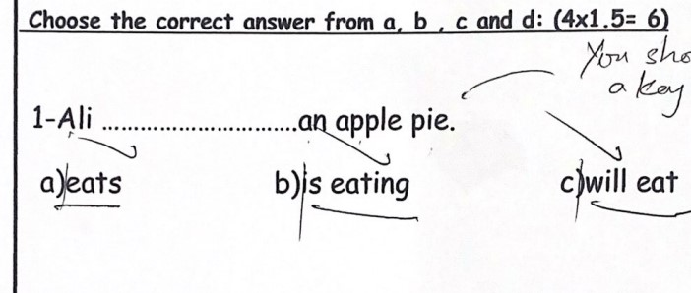

Slide 35
reading

Slide 36
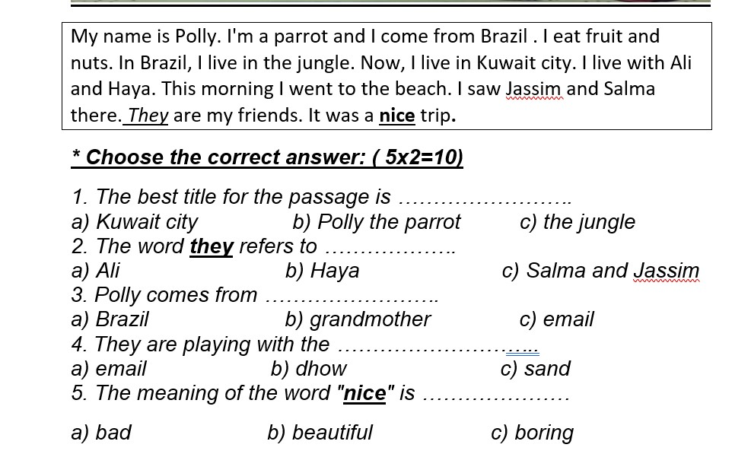

Slide 37
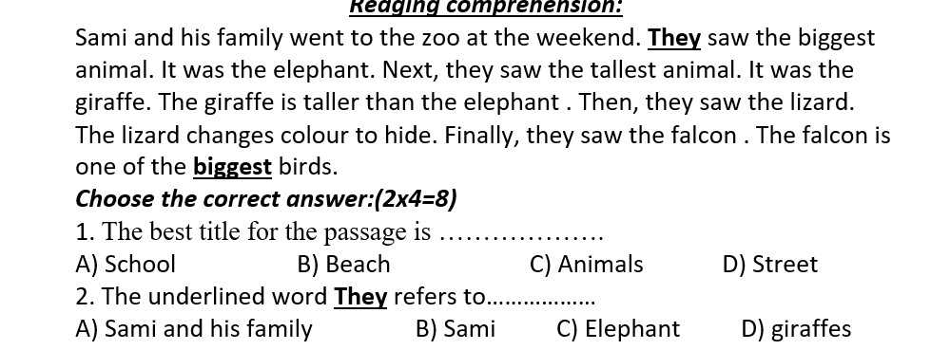

Slide 38
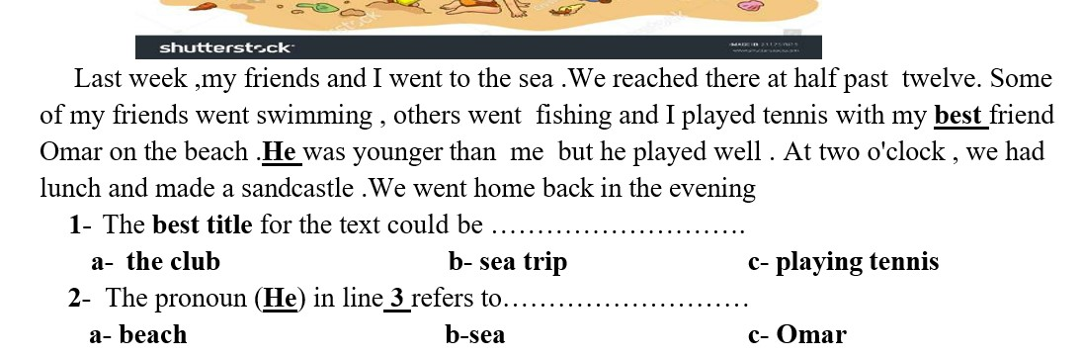

Slide 39
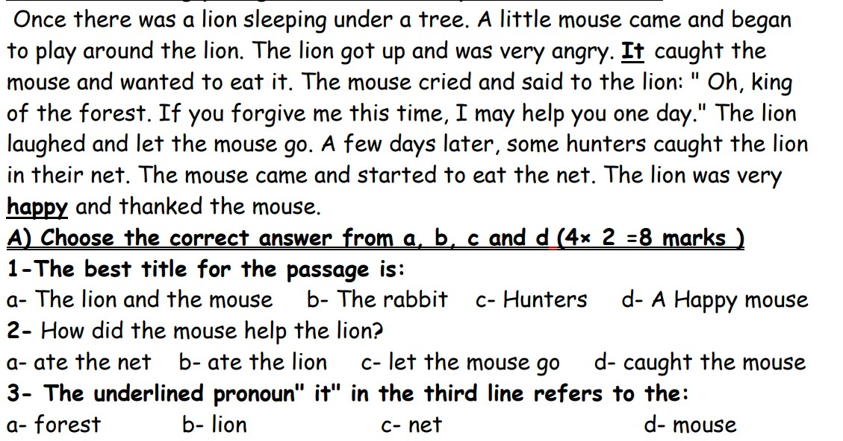

Slide 40
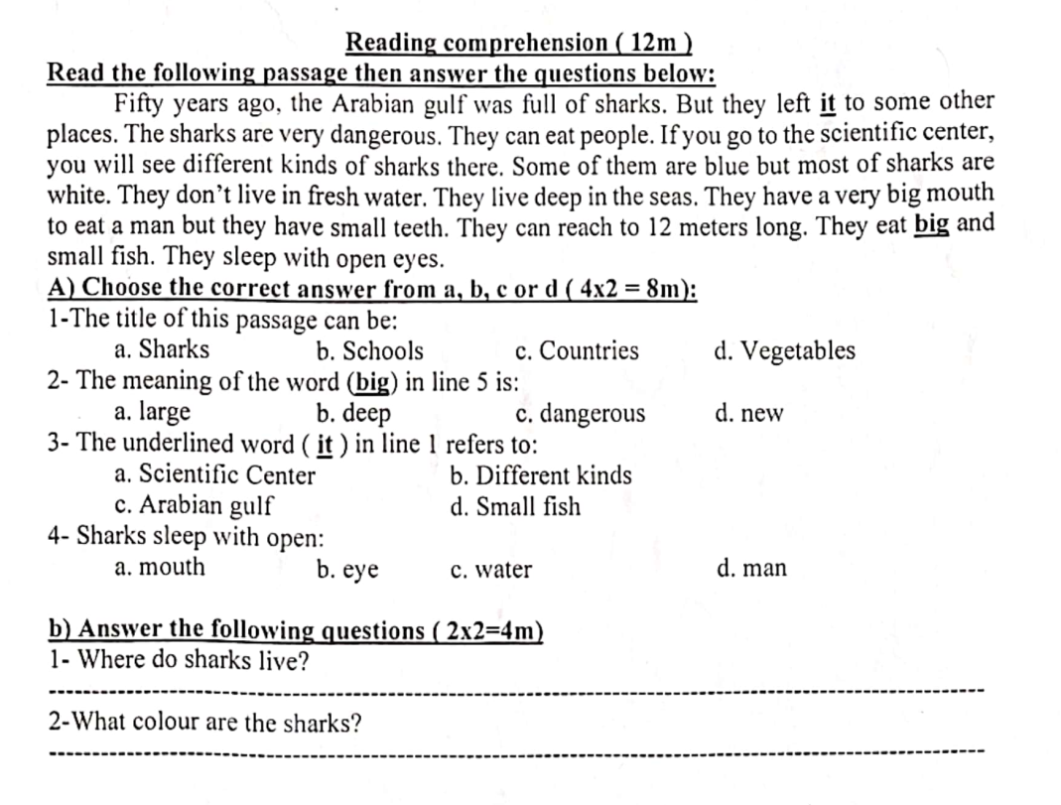

Slide 41
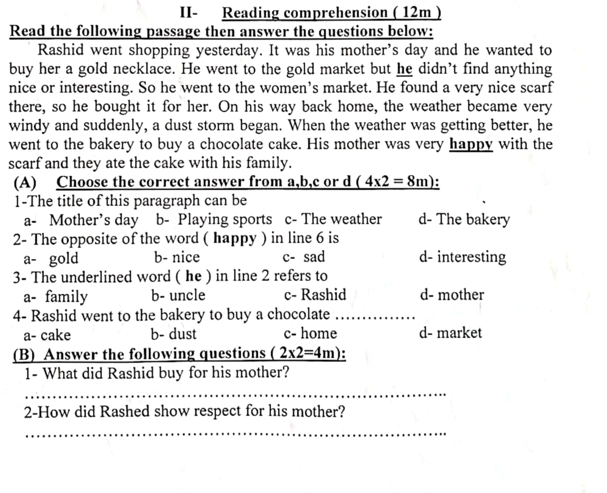

Slide 42
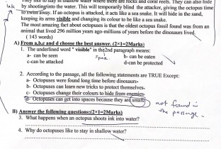

Slide 43
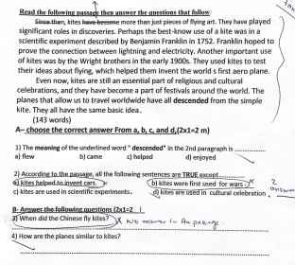

Slide 44
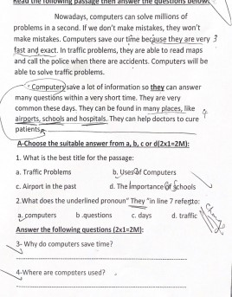

Slide 45
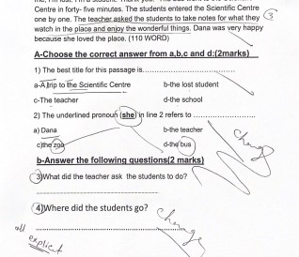

Slide 46
writing

Slide 47
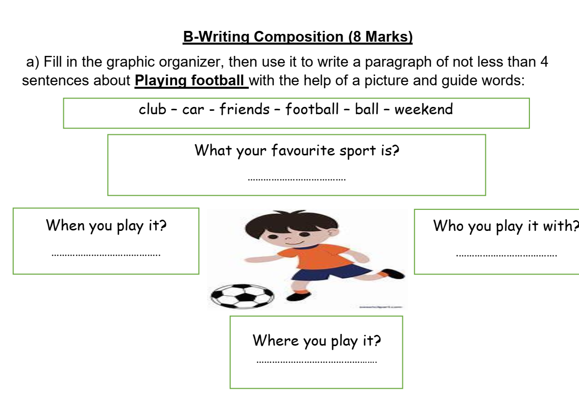

Slide 48
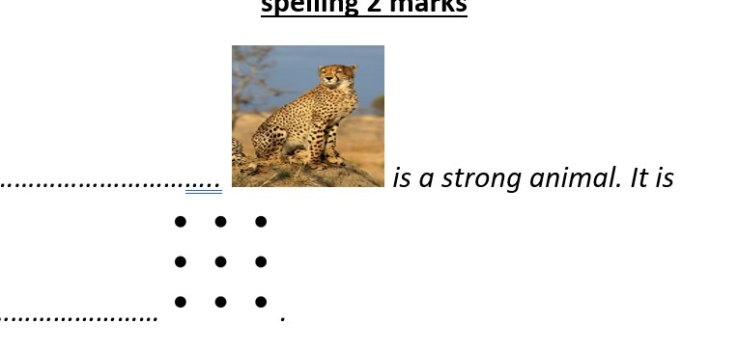

Slide 49
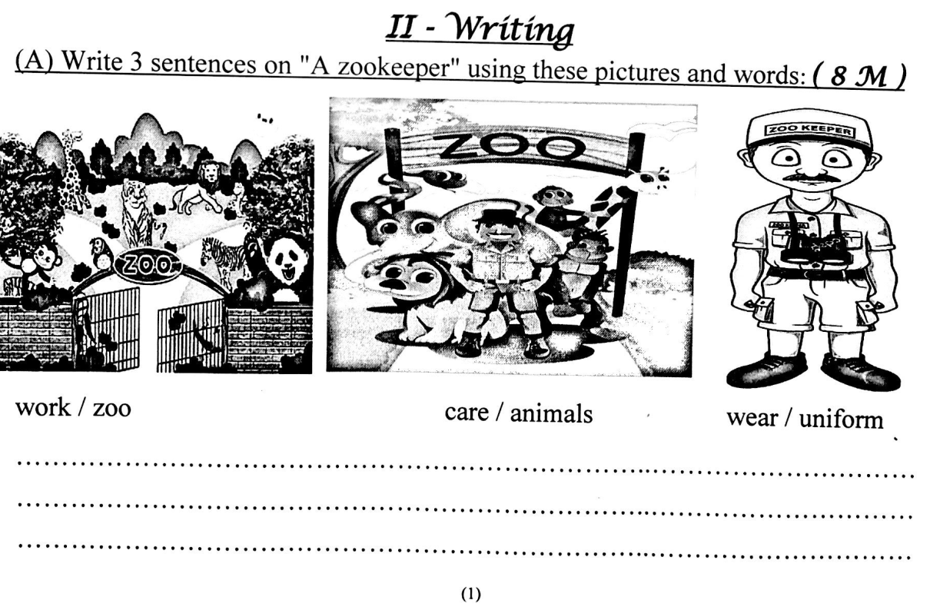

Slide 50
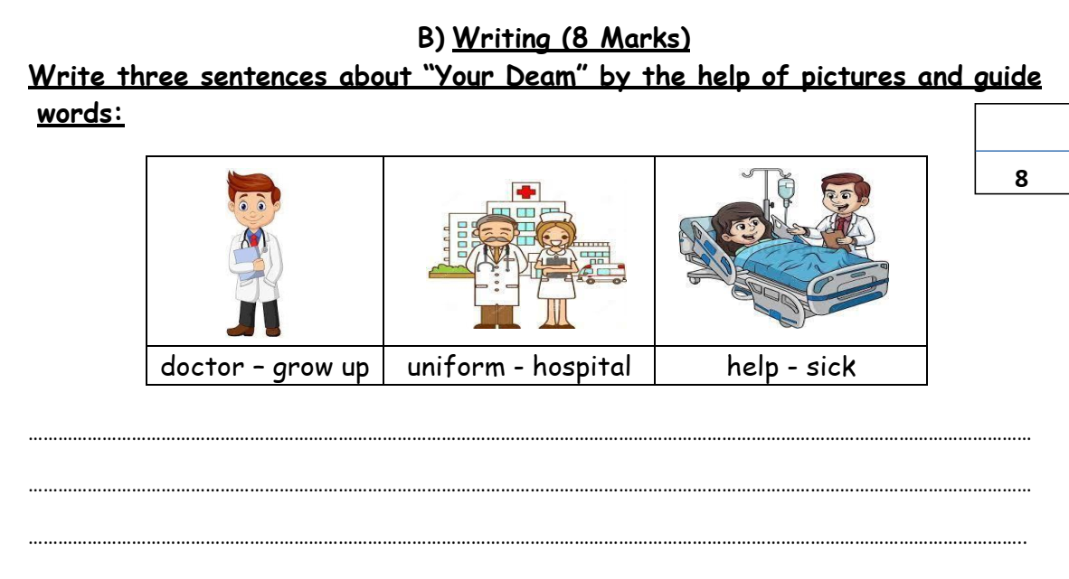

Slide 51
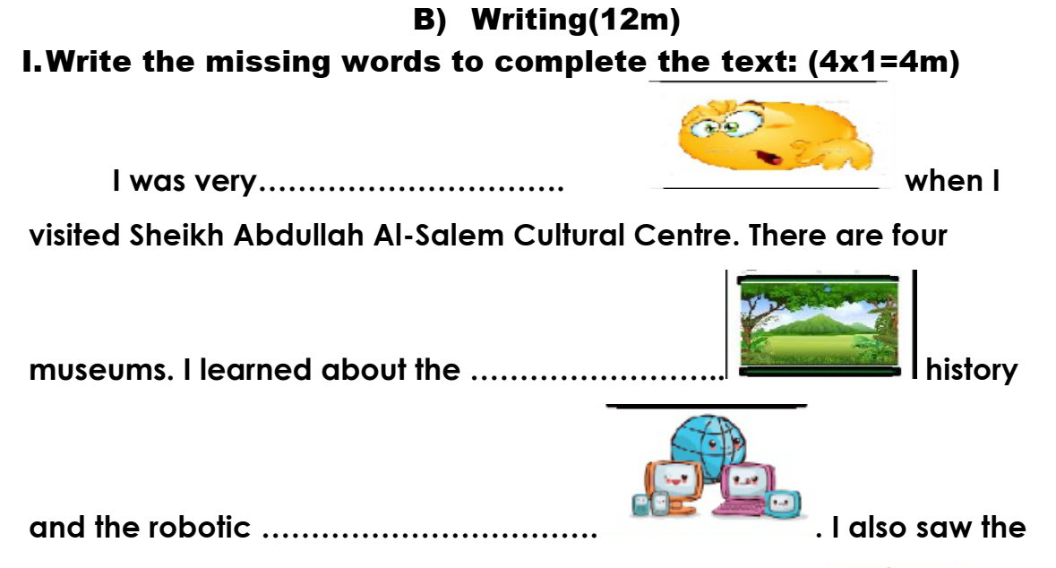

Slide 52
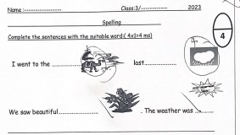

Slide 53
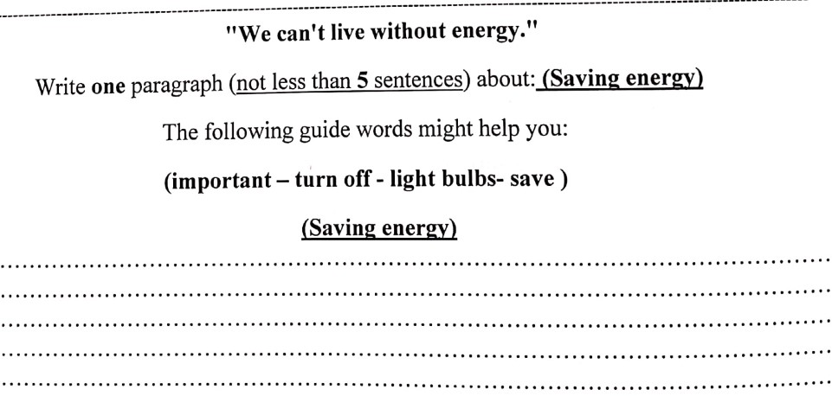

Slide 54
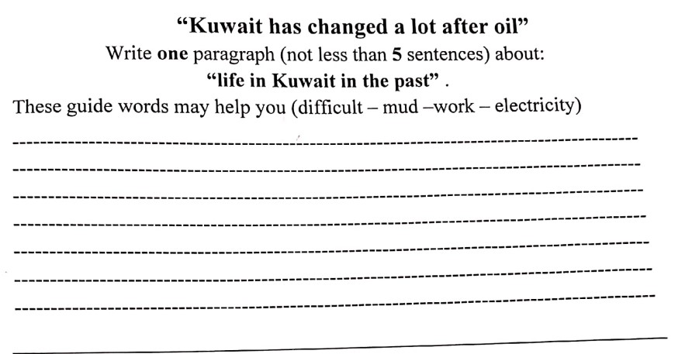

Slide 55
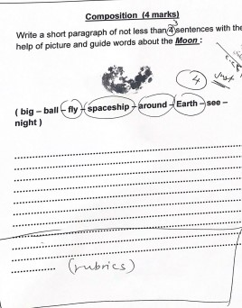

Slide 56


