Slide 1

Teaching literacy skills for dyslexic children part 2
PROFESSIONAL DEVELOPMENT
PROGRAMME
2022/2023
MINISTRY OF EDUCATION
PRIVATE SUPERVISION
2022 - 2023

Slide 2
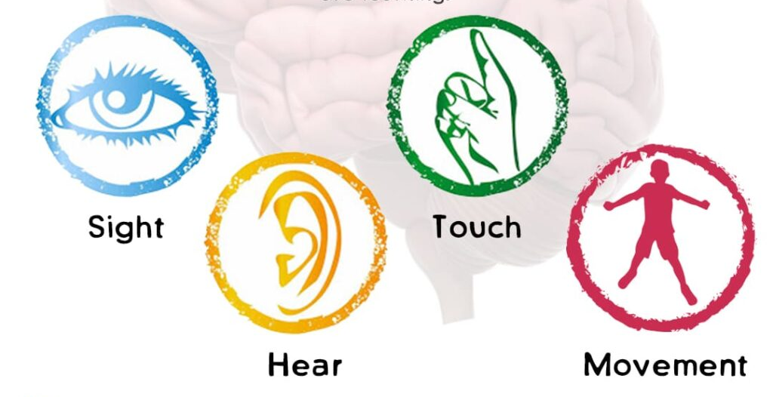
Principles of multisensory teaching of literacy skills for dyslexic learners

Slide 3
Introduction
Answer the following question?
What makes your method of teaching different and effective?

Slide 4
Main topics in part 2
Introduction
Important terms
Principles of multisensory teaching for dyslexic learners
Techniques and activities of multisensory teaching
Using Phonological training to improve reading
Teaching sight words
A suggested lesson plan

Slide 5
Important terms
Visual & auditory
Kinesthetic & tactile
Explicit vs. implicit
Synthetic and analytic phonics
Decodable texts
Sight words
Read-alouds & Guided reading

Slide 6
Important terms/2
Visual- auditory: Visual modality promotes learning through seeing / using visual displays and auditory modality focuses on listening / verbal lessons and discussions.
Kinesthetic-tactile: Kinesthetic means connected with the ability to know where the parts of your body are and how they are moving; while tactile is related to the sense of touch
Explicit vs. implicit: implicit teaching focus is to give learners' unconscious attention to form and explicit teaching focus is to give learners conscious attention to form

Slide 7
Important terms/3
Synthetic phonics: is a method of teaching where words are broken up into the smallest units of sound (phonemes). Children learn to make connections between the letters of written texts (graphemes, or letter symbols) and the sounds of spoken language.
Analytic phonics: With analytic phonics, children are taught to recognize whole words by sight, and later to break down the word into the smaller units of sound;
Sight words: Sight words are common words that kids recognize instantly without sounding them out. Recognizing words by sight helps kids become faster and more fluent readers. Examples are: at, in, what, where, yellow, brown, all, but, came, four, get, good.

Slide 8
Important terms/4
Read-alouds: According to Wright (2015), “read alouds are sessions during which a teacher, parent, or other proficient reader reads aloud from a book or other text to one or more students” (p. 197). Read alouds are very effective with helping learners learn to read.
Guided reading: is a small-group instructional context in which a teacher supports each reader's development of systems of strategic actions for processing new texts at increasingly challenging levels of difficulty.
Decodable text: is a type of text used in beginning reading instruction. Decodable texts are carefully sequenced to progressively incorporate words that are consistent with the letter–sound relationships that have been taught to the new reader.

Slide 9
What is multisensory structured teaching?
Multisensory teaching is explicit, direct, cumulative, intensive, and focused on the structure of language.
Multisensory learning involves the use of visual, auditory, and kinesthetic-tactile (VACT) pathways simultaneously to enhance memory and learning of written language.
Links are consistently made between the visual (language we see), auditory (language we hear), and kinesthetic-tactile (language symbols we feel and move) pathways in learning to read and spell.

Slide 10
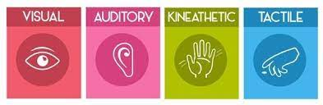
What are the principles of a multisensory approach?

Slide 11
What are the principles of a multisensory approach?
A-Simultaneous, Multisensory (VAKT):
Teaching uses all learning pathways in the brain (i.e., visual, auditory, kinesthetic-tactile) simultaneously or sequentially in order to enhance memory and learning.
B-Systematic and Cumulative:
Multisensory language instruction requires that the organization of material follows the logical order of the language. The sequence must begin with the easiest and most basic concepts and progress methodically to more difficult material.
Each concept must also be based on those already learned. Concepts taught must be systematically reviewed to strengthen memory.

Slide 12
What are the principles of a multisensory approach?/2
C- Direct Instruction:
The inferential learning of any concept cannot be taken for granted. Multisensory language instruction requires direct teaching of all concepts with continuous student-teacher interaction.
D- Diagnostic Teaching:
The teacher must be skillful at flexible or individualized teaching. The teaching plan is based on careful and continuous assessment of the individual’s needs. The content presented must be mastered step by step for the student to progress.

Slide 13
What are the principles of a multisensory approach?/3
E- Synthetic and Analytic Instruction:
Multisensory, structured language programs include both synthetic and analytic instruction.
Synthetic instruction presents the parts of the language and then teaches how the parts work together to form a whole.
Analytic instruction presents the whole and teaches how this can be broken down into its component parts.

Slide 14
What are the principles of a multisensory approach?/4
F-Comprehensive and Inclusive:
All levels of language are addressed, often in parallel, including sounds (phonemes), symbols (graphemes), meaningful word parts (morphemes), word and phrase meanings (semantics), sentences (syntax).
G-Incorporate metacognitive activities: essentially it involves thinking about thinking and the learners self-questioning of how a particular response was arrived at.
H-Be reinforcing – skills which are learnt need to be practiced, learned and preserved in long term memory. This can be achieved through reinforcement and is in fact necessary for automatic access of the word or skill which has been learnt.

Slide 15
Techniques and activities of multisensory teaching
Phonics
Decodable reading
Review
Comprehension
Tactile Reinforcement
Mouth movement & Finger tapping
Syllabication rules

Slide 16
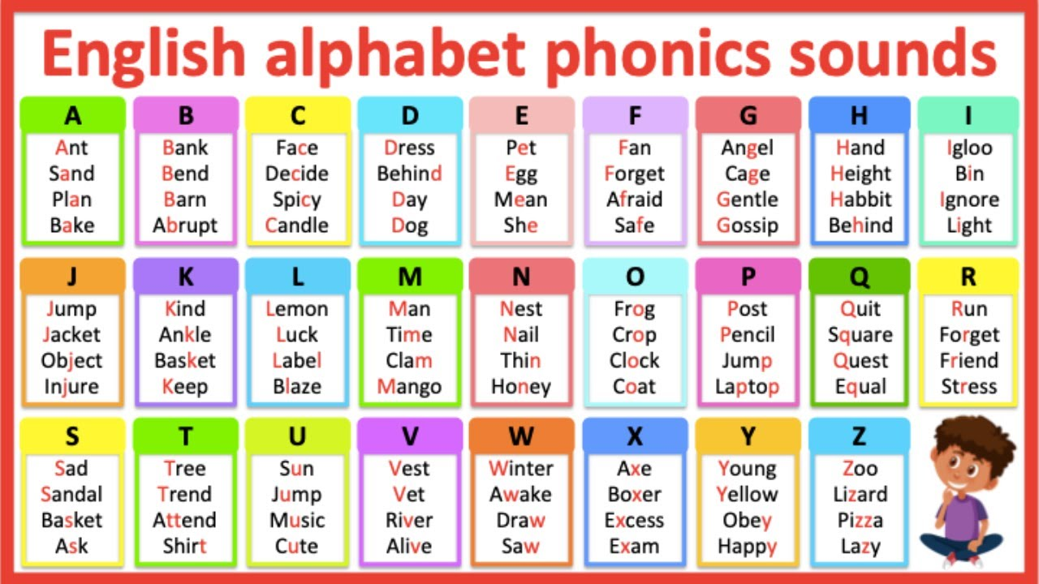
Phonics

Slide 17
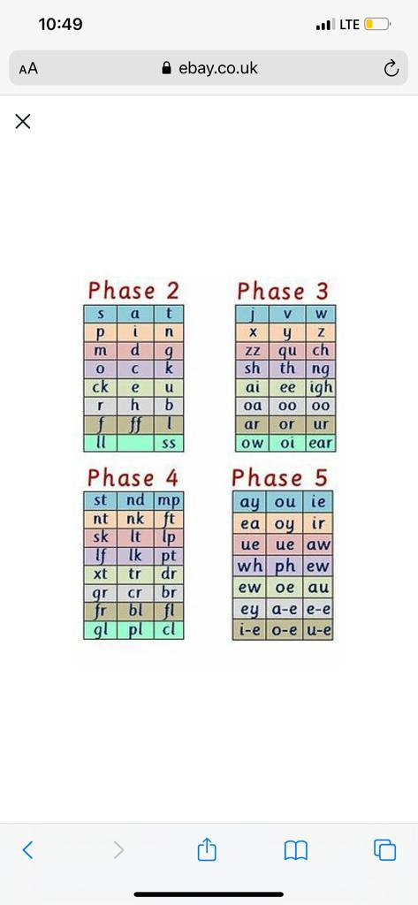
Phonics

Slide 18
Practical tips to teach phonics
Use “Alphabet Chart” with pictures to teach alphabet letters and letter sounds.
Point to each letter and ask your child, “Tell me what this letter says.”
Point to each letter as you are saying the letter name and the letter sound.
Review the alphabet chart once a day and pretty soon your child will be able to point to each letter and say the sounds himself.
Help your child to create his own “Alphabet Book” to learn most of the alphabet letter sounds by drawing pictures of items that begin with the sound of each alphabet letter.

Slide 19
Practical tips to teach phonics/2
Help your child to create his own “Alphabet Book” to learn most of the alphabet letter sounds by drawing pictures of items that begin with the sound of each alphabet letter.
Ask your child to tell you the letter sound, not the letter name.
Say and let him repeat the letter sounds that he misses. This is a good place to begin fixing your child’s auditory gaps.

Slide 20
Decodable reading
A decodable text refers to words containing only the phonetic code the child or student has already learned. We often think of ‘decodable’ text as phonetically simple words and text.

Slide 21
The importance of decodable reading
1. The use of decodable text forces readers to practice their decoding skills instead of relying on pictures or guessing.
2. It helps strengthen orthographic memory.
3. Children learn to apply their knowledge of explicitly taught phonics skills or spelling concepts.
4.Good decodable text follow a systematic progression
5.Decodable texts are a big step toward fluent independent reading.

Slide 22
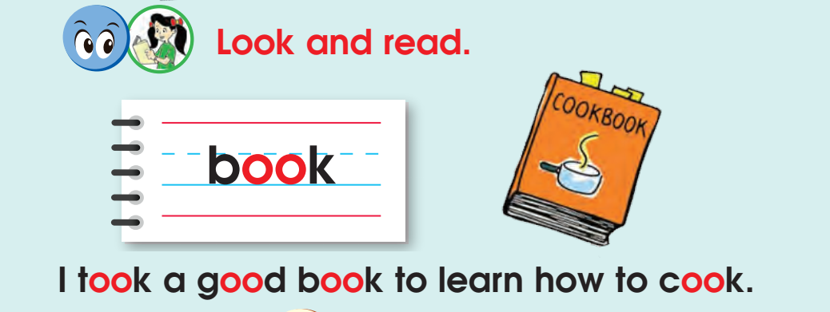

Slide 23
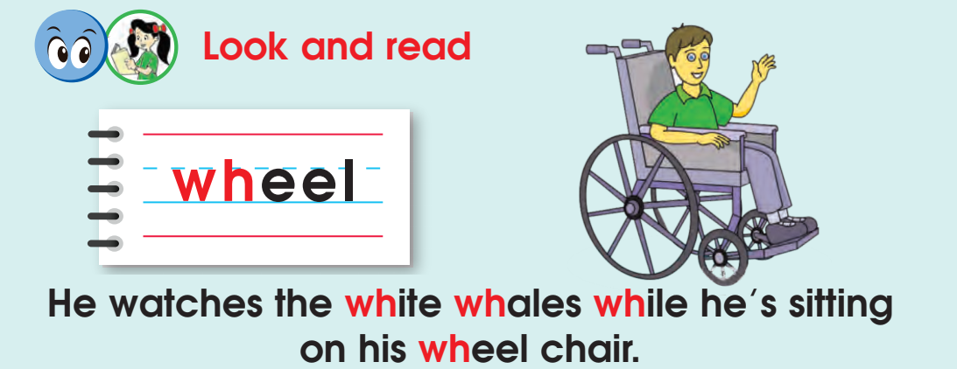

Slide 24
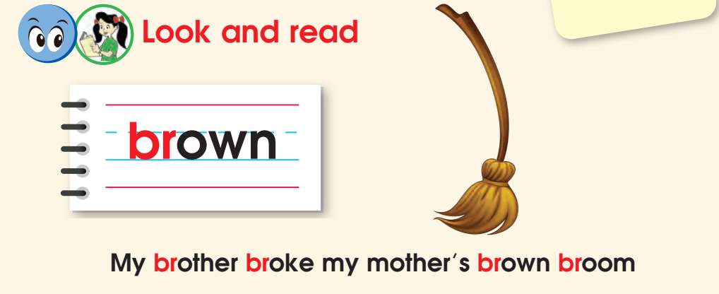

Slide 25
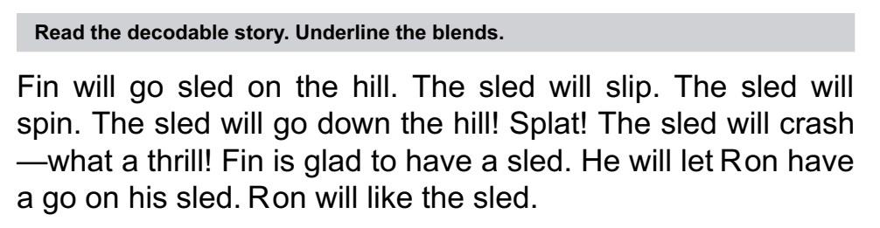
A decodable story

Slide 26
Review
Review is a crucial part of any multisensory lesson. Students with dyslexia and other reading differences depend on the explicit nature of the multisensory approach.
A consistent routine with a review at its forefront helps students build the necessary phonetic skills needed in order to build connections.
We recommend devoting 10 minutes at the beginning of each lesson to review previous concepts, spelling rules, and sight words.

Slide 27
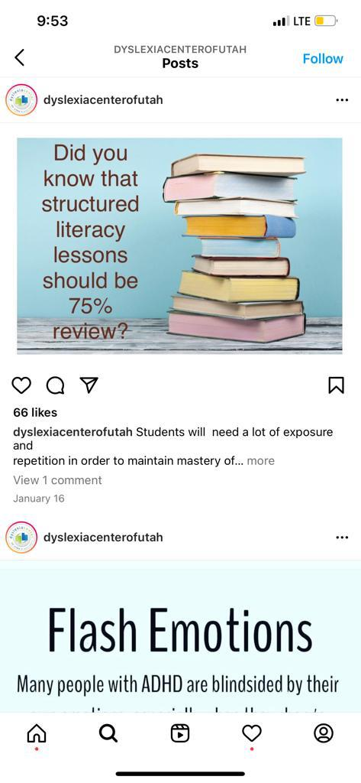

Slide 28
Comprehension
20 minutes of phonics instruction is recommended with an additional 15–30 minutes of comprehension instruction.
Phonics is essential to improving students’ fluency (and therefore enjoyment of reading). It is likely that reading comprehension will improve with time using this program.
Reading comprehension can be taught through read-alouds and guided reading. Research has shown that reading instruction is most effective when utilizing authentic novels, stories, and articles as opposed to textbooks.
To make your comprehension lesson as effective as possible, include instruction on comprehension skills within a variety of texts.

Slide 29
Comprehension/2
To make your comprehension lesson as effective as possible, include instruction on comprehension skills within a variety of texts.
Be sure to include instruction in one of these skills in each reading lesson:
• Making connections & Visualizing
• Retelling & Wondering
• Making inferences
• Determining important ideas
• Text features & Text structure
• Author’s purpose & Synthesizing information across multiple sources

Slide 30
Tactile Reinforcement:
Using a tactile material (sand, small beads, shaving cream, hair gel, sandpaper, rug squares, etc.), call out sounds or words for students to write.
Circulate while they work, and always demonstrate the correct sound to ensure that students are able to self-correct as needed.
In order to make the lessons multisensory, it is helpful to have the following materials: Pencils, index cards, plastic tray for tactile writing, tactile material for the tray, such as sand, shaving cream, or plastic water, beads, magnetic board, letter magnets, play-Doh, surfaces with interesting textures, such as sandpaper, carpet squares, or fabric.

Slide 31
Mouth Movement
The explicit nature of teaching mouth movements is helpful for young children who are having difficulty connecting graphemes (letters) to sounds.
The mouth chart can be used to offer students a visual representation as to how their mouth should look when articulating each letter sound.
If you would like more detailed instruction on the proper mouth movements.
https://www.treetopseducation.com/videos

Slide 32
Finger tapping
Finger tapping is a must when using multisensory teaching method. Tapping helps build the idea that sounds and graphemes are connected. This multisensory method is easy to implement and essential within the OG approach.
Students need to understand that letters have their own sounds, but they slide into the next sound without pause. Teach students to tap on the hand they do not write with so they can practice tapping as they write.
To be clear, finger tapping is more about associating sounds with letters, so tapping will not include silent letters. For words with more than five sounds, students can start again from their first finger.

Slide 33
Syllabication Rules
Syllabication is the process of dividing a word into its component sounds, called syllables. Syllabication is necessary in pronouncing words correctly, and many children need a great deal of help in learning syllabication.
Rules of syllabication:
1. All syllables have one vowel sound.
2. Compound words should be divided between the two base words.
3. If two consonants appear in between two vowels, divide them in half.
4. If three consonants appear between two vowels, determine which two belong together. Blends and digraphs should not be separated.

Slide 34
Syllabication Rules/2
5. When one consonant is in-between two vowels, first try dividing after the consonant to keep the vowel “closed in.” If that doesn’t sound right, try dividing before the consonant to keep the vowel open.
6. Never divide a vowel team or diphthong in half.
7. If there are two vowels in the middle of a multisyllabic word that do not work as a team, divide them in half.
8. The syllable type consonant -le pattern is its own syllable and should be divided as one.

Slide 35
Using Phonological training to improve reading and spelling

Slide 36
Principles of teaching phonological skills
Multisensory teaching brings together at the same time the following: what a letter or a word looks like, how it sounds, how the speech organs are used to pronounce it, and what hand moves are needed to write it.
Students can memorize words better by forming them from wooden, sponge or plastic letters. Tracing words on different surfaces such as sandpaper or wood and making models from clay is also effective.

Slide 37
Principles of teaching phonological skills/2
Mnemonics, movement and drawing help to remember the words as well. Finger tapping or clapping can aid learners to count the number of syllables or sounds in words.
Cards and tokens are used in both sound awareness and spelling activities to represent sound units or spelling choices and to help learners manipulate them. These cards are also colour-coded to highlight difficult sounds or spelling choices.

Slide 38
Phonological training activities
Phonological training activities are a lot. Some skills are related to rhyme manipulation as rhyme recognition, differentiation and production. Others are related to manipulation of sounds as blending, segmenting and deletion, substitution and addition.
1. For segmenting and blending tasks students can use cards and tokens to represent the actions of breaking apart and putting together. They listen to the teacher saying a sentence or a word and place a token from the left to the right for each word or syllable heard, or they listen to constituent parts and put them together to form a word.
2. To make the boundaries between words, syllables or sounds clear, teachers can use a teaching aid made of tokens fastened to the elastic band; they simply need to stretch the band.

Slide 39
Phonological training activities/2
3. When segmenting and blending onsets and rimes, we use sets of words that share a rime. Colour-coding is used to help students distinguish between onsets and rimes. It also helps to understand that changing only the beginning sound, which is represented by a given letter or a combination of letters, results in forming a new word. Students manipulate tokens and word slides to form words, they also read and spell these words.
4. The next stage is identifying the position of sounds in words, followed by manipulation tasks in which students leave off, add or substitute the beginning, final or medial sound in a given word to form a new word.

Slide 40
Phonological training activities/3
5. Combining multisensory techniques and the explicit teaching of spelling rules can be of great help for students with dyslexia, especially with regard to sounds that have several possible spelling choices.
6. Colour-coding, flash cards, games, word slides and flip cards are used for drilling the spelling. Drills involve also reading the words aloud and writing them down in special charts.
7. Word slides: have a set part containing the letters which represent a given rime or individual sound shared by all the words being practised. Word slides also contain one or more movable parts with different letters.

Slide 41
Phonological training activities/4
When students manipulate these movable parts, they form new words. Flip cards comprise several piles of cards joined at the top with a spring so that they can be flipped over to show combinations of letters which are used to form words.
8. Cards for reading and tracing drill, spelling choice stickers, dominoes, bingo, graphic models of words and odd-one-out tasks can be used for consolidating spelling.

Slide 42
Teaching sight words
What are sight words?
Why are sight words important?
Techniques of teaching sight words

Slide 43
Why are sight words important?
Sight words are high frequency words, which are sometimes non-phonetic, that should be memorized. To be clear, there are very few words that do not follow the conventional rules of English.
Sight word instruction can improve students’ overall reading abilities.
Sight word instruction can improve students’ confidence in reading.
Sight word instruction alone is not beneficial without other literacy instruction.

Slide 44
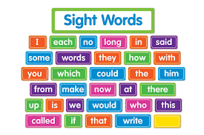

Slide 45
Teaching techniques of sight words
The most common and basic way to familiarize students with sight words is to present them in a flashcard drill and practice format.
Flashcards allow students to see the word numerous times in the same setting and will help them to memorize the words easier.
Technology programs ( Coleman et al. (2015) and Yaw et al. (2012) have both found successful computer-based sight word programs that can be used during interventions with students with disabilities.

Slide 46
Teaching techniques of sight words/2
1. First, introduce the word by writing it in pencil on a blank index card. Write the word slowly to model correct letter formation. Place the index card in front of the students.
2. Now, model arm tapping.
3. Next, place the index card with the word written in pencil over a bumpy board.
4. Ask students to trace the word on an index card with a crayon.
5. Tell students to use the index finger from their dominant hand to trace the word as they say the letters.
6. During the week, students are consistently reading and spelling the sight words correctly.
7. To complete the Sight Words portion of the lesson, tell students to write sentences using each of the week’s sight words in their notebook.

Slide 47
A suggested Lesson plan for dyslexic children
Review | Review previously learned skills/concepts (phonological awareness, sound-symbol relationships, decoding, encoding, etc.). | 4 minutes
Present new concept | Explicitly teach new skill(s) for the day (incorporating multisensory engagement strategies as appropriate) | 12 minutes
Comprehension | Practice reading decodable sentences and texts in which a student can sound out the majority of words (~70-85%). | 12 minutes
Sight words | Work on no more than three unfamiliar words at a time to make it manageable for your child. Introduce one word at a time; | 6 minutes
Dictation | Practice writing/spelling sound-symbol relationships in isolation (e.g., a, e, t, k, ai, ea, ch, sh, igh) and decodable words | 5 minutes

Slide 48


