Slide 1


Teaching literacy skills for dyslexic children
Theory and practice part 1
MINISTRY OF EDUCATION
PRIVATE SUPERVISION
2022 - 2023

Slide 2
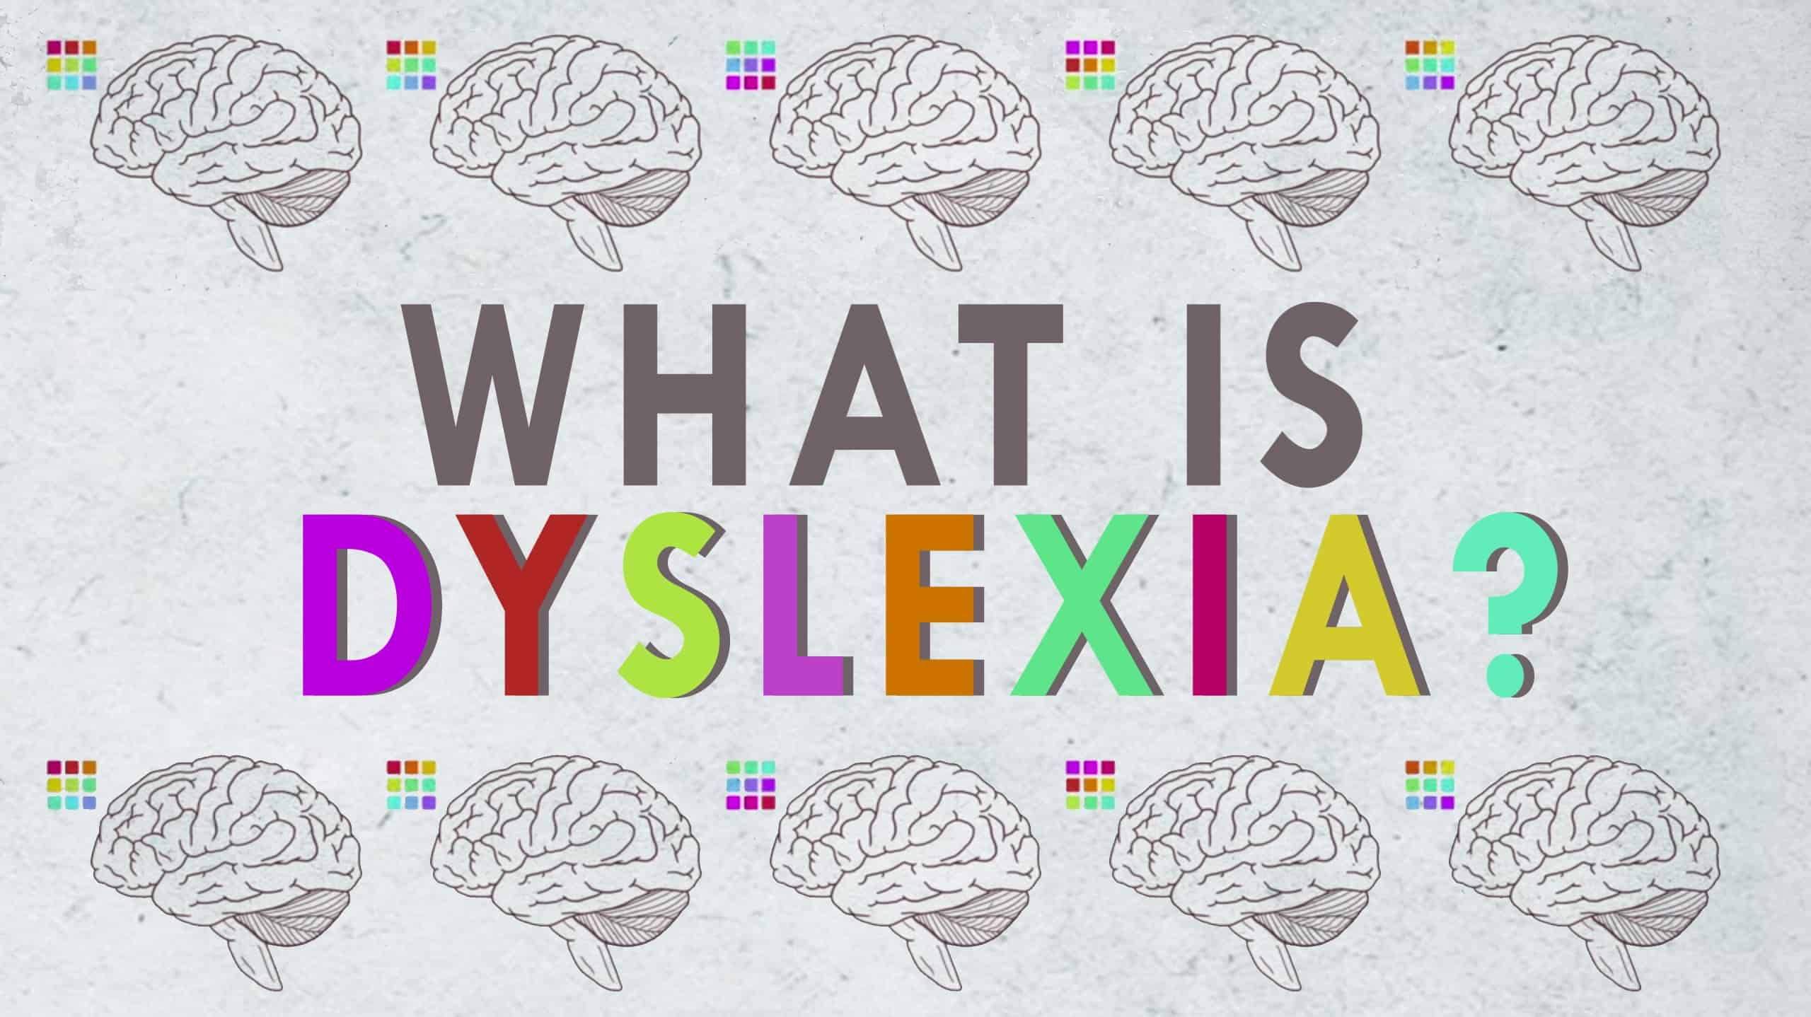
Part 1

Slide 3


Slide 4
Main topics in part 1
Introduction
Important terms
Simple view of reading
Definition of dyslexia & the features of dyslexic learners
Literacy difficulties and their causes
Identification and diagnosis of dyslexia

Slide 5
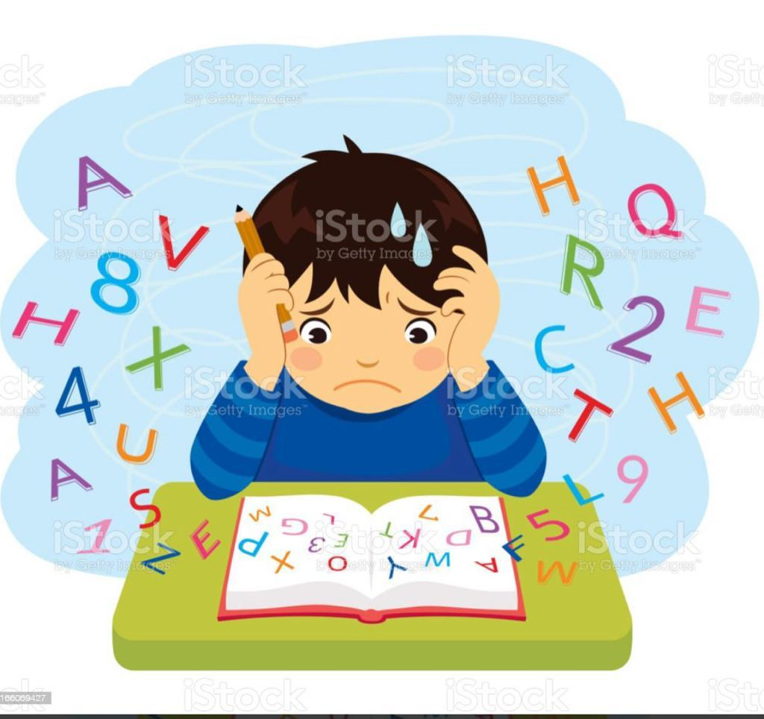
https://www.youtube.com/watch?v=b1b2rHhFajE
Introduction
Reflect on the following video and write down your comments

Slide 6
Important terms
Dyslexia
Decoding and encoding
Phonological skills
Phonological & phonemic awareness
Phonics
Alphabetic principle
Working memory
Speed of processing
Literacy & Literacy difficulties

Slide 7
Task 1
Watch the video and write down ” What is dyslexia? “
https://www.youtube.com/watch?v=zafiGBrFkRM

Slide 8
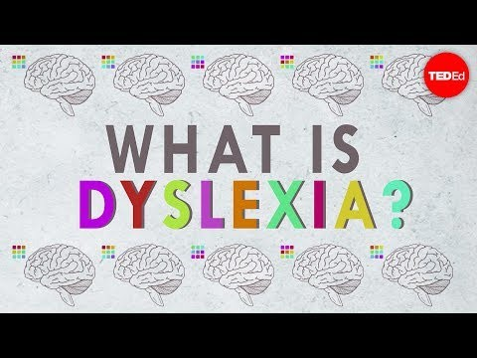

Slide 9
Dyslexia (BDA, 2009)
Dyslexia: is a learning difficulty that primarily affects the skills involved in accurate and fluent word reading and spelling. The word “Dyslexia” originated from the Greek language. “Dys” refers to difficulty and “lexia” refers to with words.
Characteristic features of dyslexia are difficulties in phonological awareness, verbal memory and verbal processing speed.
Dyslexia occurs across the range of intellectual abilities. (IQ)
It is best thought of as a continuum, not a distinct category, and there are no clear cut-off points.
Co-occurring difficulties may be seen in aspects of language, motor co-ordination, mental calculation, concentration and personal organization, but these are not, by themselves, markers of dyslexia

Slide 10
Decoding & encoding
Decoding: is the process of reading words in text. When a child reads the words 'The ball is big,' for example, it is necessary to understand what the letters are, the sounds made by each letter and how they blend together to create words.
Encoding: is the process of using letter/sound knowledge to write. If a student were to write that same sentence, instead of making sense of the letters in text, it is necessary to recall sounds and the symbols assigned to them to write the letters together to form words.
Dyslexic children: tend to struggle with word reading and spelling.
Word attack skills: involve the ability to recognize the phonemes that form a word and to know the meaning of the word, recognize it in context, and understand whether or not it is correctly used in a sentence.

Slide 11
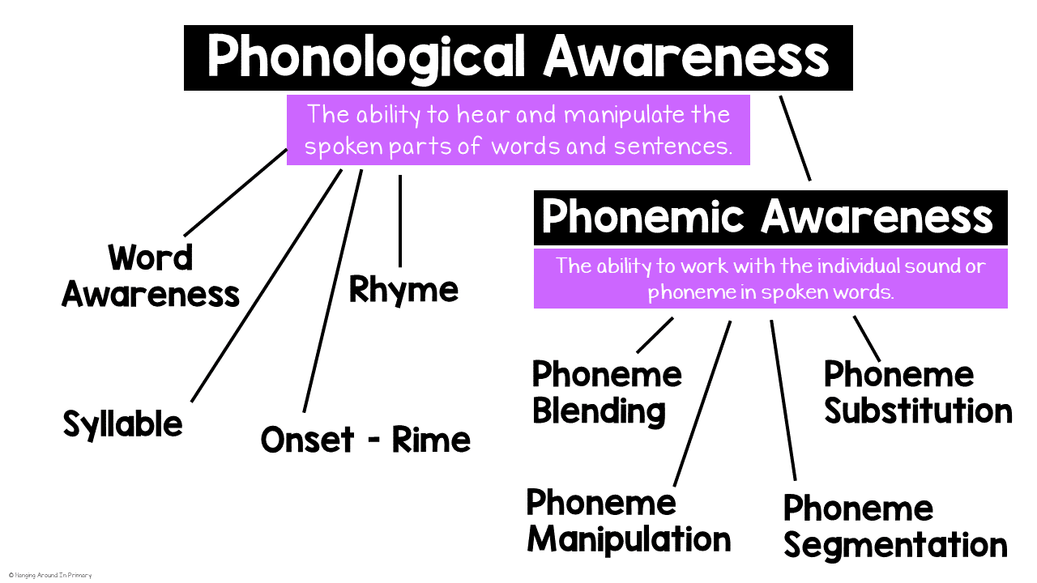
Phonological skills

Slide 12
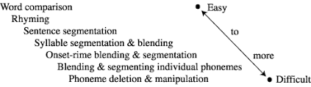

Slide 13
Phonological skills/1
Phonological awareness: is the ability to identify and manipulate the sounds in words. This is recognised as a key foundation skill for early word-level reading and spelling development.
For example, phonological awareness would be demonstrated by understanding that if the ‘p’ in ‘pat’ is changed to an ‘s’, the word becomes ‘sat’.
Dyslexic children: tend to struggle with phonological skills.
Phonological skills can be divided into many types: phoneme deletion, phoneme blending, phoneme segmentation, sentence segmentation, rhyming and syllable awareness.

Slide 14
Phonological skills/2
Phonemic awareness: is the ability to hear and manipulate the smallest unit of sound in spoken language. The smallest unit of sound in the English language is called a phoneme.
Alphabetic principle” “is connecting letters with their sounds to read and write.” For example, a child who knows that the written letter “m” makes the /mmm/ sound is demonstrating the alphabetic principle.
Phonics: is a way of teaching children how to read and write. It helps children hear, identify and use different sounds that distinguish one word from another in the English language.

Slide 15
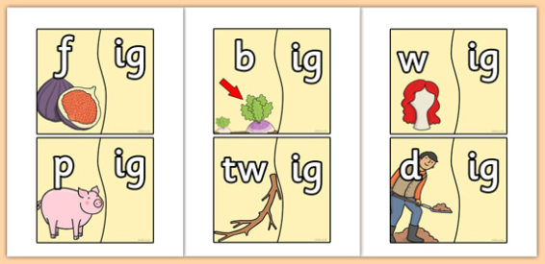
Phonological skills/3
Onset & Rime: Onset-rime segmentation is the process of breaking or separating words into two parts: the onset, which is the consonant or cluster of consonants at the start of a syllable, and the rime, the remainder of the syllable. For example, in the word CLIMB, cl- is the onset and -imb is the rime.

Slide 16
Working memory
Working memory (WM): can be defined as our ability to simultaneously hold and manipulate information over a brief period of time. The amount of information we are able to hold and process or manipulate simultaneously in our mind at any given time is called our WM capacity. Our WM capacity is limited and developed as we get older and varies among individuals.
Children with dyslexia generally show deficits in working memory and having phonological awareness and word reading efficiency problems.
A commonly used measure of working memory is the digit span backwards (Lezak, 2004).

Slide 17
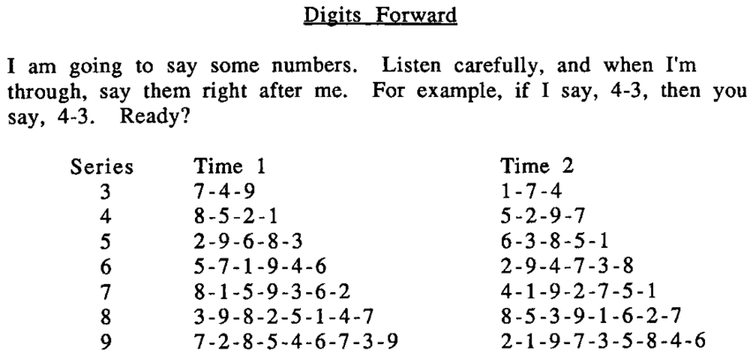
Forward digit span

Slide 18
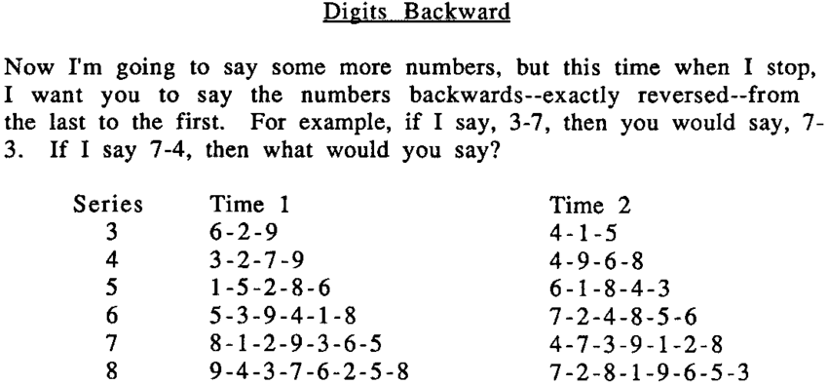
Backward digit span

Slide 19
Speed of processing
Processing speed: involves the amount of time it takes to perceive information, process information, and formulate or enact a response. Another way to define processing speed is to say that it’s the time required to perform an intellectual task or the amount of work that can be completed within a certain period.
There are three main components of processing speed (Burgess, 2016):
Visual processing: how quickly a student’s eyes perceive information and relay it to the brain (such as reading directions or noticing a teacher’s hand gestures)
Auditory processing: how quickly a student hears a stimulus and reacts to it (such as following oral instructions or participating in a discussion)
Motor speed: how strong a student’s fine-motor agility is, leading to academic fluency (such as filling out timed math worksheets).

Slide 20

Automatization
Automatization: is central concept to reading fluency; it is composed of both speed and accuracy. In dyslexic readers, attention is divided into both decoding words and constructing meaning while fluent readers focus mainly on comprehension skills because decoding is automatized.

Slide 21
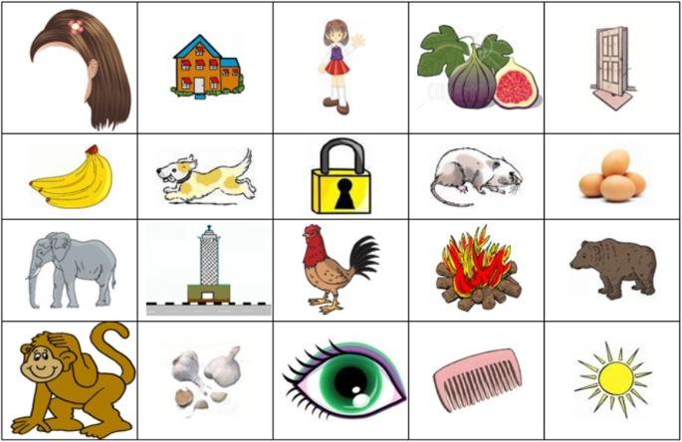
Rapid automatized naming

Slide 22
Task 2
Read the following statements and match the definitions:

Slide 23
No. | answer | Definition
1.The onset |  | is a way of teaching children how to read and write.
2.Processing speed |  | can be defined as our ability to simultaneously hold and manipulate information
3. Phonics |  | is the process of reading words in text.
4.Decoding |  | involves the amount of time it takes to perceive information, process information
5.Alphabetic principle |  | is connecting letters with their sounds to read.
6.Phonemic awareness |  | is the ability to hear and manipulate the smallest unit of sound in spoken language.
7.Working memory |  | is the process of using letter/sound knowledge to write
8.Encoding |  | is the consonant or cluster of consonants at the start of a syllable

Slide 24
No. | answer | Definition
1.The onset | 3 | is a way of teaching children how to read and write.
2.Processing speed | 7 | can be defined as our ability to simultaneously hold and manipulate information
3. Phonics | 4 | is the process of reading words in text.
4.Decoding | 2 | involves the amount of time it takes to perceive information, process information
5.Alphabetic principle | 5 | is connecting letters with their sounds to read.
6.Phonemic awareness | 6 | is the ability to hear and manipulate the smallest unit of sound in spoken language.
7.Working memory | 8 | is the process of using letter/sound knowledge to write
8.Encoding | 1 | is the consonant or cluster of consonants at the start of a syllable

Slide 25
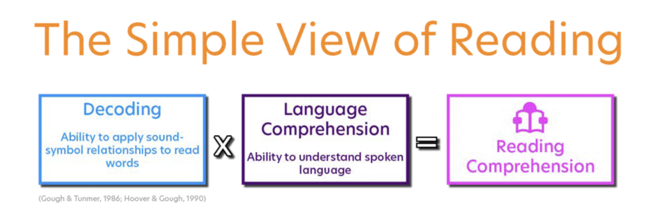
Simple view of reading (Gough, 1986)

Slide 26
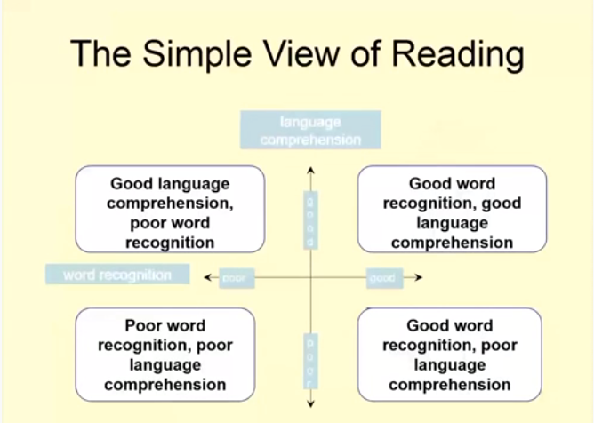

Slide 27
Simple view of reading (Gough, 1986)
Simple view of reading proposes that dyslexia primarily affects the skills involved in accurate and fluent word reading and spelling. Consequently, those children whose reading performance falls within either the upper or the lower left quadrants most likely include those children who are experiencing dyslexic difficulties because their performance indicates varying degrees of poor word recognition.
The definition notes that cognitive difficulties associated with dyslexia include phonological awareness, verbal memory and verbal processing speed. Children with good and poor language comprehension can have such difficulties.

Slide 28
Simple view of reading (Gough, 1986)/2
All reading difficulties fall into one of three general types. The Simple View of Reading (SVR) demonstrates that reading difficulties fall into three basic types:
1. Poor at Language Comprehension — Has adequate decoding skills and weak language comprehension skills.
2. Poor at Decoding — Has adequate language comprehension and weak decoding skills. The extreme example of this profile is a dyslexic student (a student with language comprehension abilities that are at least average and severe decoding difficulties).
3. Weaknesses in Both Areas — Has weaknesses in both areas; sometimes referred to as the “Garden Variety” poor reader.

Slide 29
Task 3
What are the benefits of simple view model?

Slide 30
Benefits of Simple View Of Reading (SVR)
Teaching methodology: when we start teaching literacy skills, we focus on skills of decoding and comprehension of language ( grammar and vocabulary).
Dyslexia identification: through stage models and observation of learners, educators can identify the real stage should we start from concerning reading and spelling.
Remedial plans: they should be prepared based on the entire models; so relevant plans can help make authentic plans.

Slide 31
Task 4
Watch the video and write down the language-related signs of dyslexia in different ages?

Slide 32
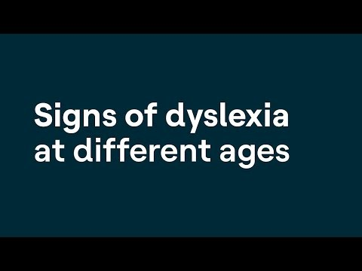

Slide 33
Developmental phase | Signs of dyslexia (Snowling, 2008)
Preschool | Delayed or problematic speech. Poor expressive language. Poor rhyming skills. Little interest/difficulty learning letters.
Early school years | Poor letter-sound knowledge. Poor phoneme awareness. Poor word attack skills. Idiosyncratic spelling. Problems copying.
Middle school years | Slow reading. Poor decoding skills when faced with new words. Phonetic or non-phonetic spelling.
Secondary school years | Poor reading fluency. Slow speed of writing. Poor organization and expression in work.

Slide 34
Literacy & literacy difficulties
Literacy: is believed to be associated with acquiring a level of reading, writing, and communication that allows individuals to attain competency in achieving personal goals, in developing to one’s full potential, and in functioning successfully in a job and within the global society.
Literacy difficulties: A child with a reading problem shows difficulties in reading skills which are unexpected according to age, cognitive ability, intervention and quality and quantity of instruction. The problem is not as a result of developmental delay or sensory impairment.
It may be described by difficulties in single word reading, sounding out words/letters, reading sight words, comprehension, inadequate phonological processing, for instance, they cannot understand that sentences consist of words, words are comprised of syllables which are also made up of single sounds or phonemes.

Slide 35
Literacy & literacy difficulties/2
The processing problem can also be seen in spelling and writing which are usually common with reading problem.
Pupils with writing problem have difficulties in writing to communicate their ideas. They may present difficulties in making sentences, using punctuation in sentences and using grammatically accepted vocabulary and paragraph organization.
It may be difficult for someone to read their handwriting as some of them write letters upside down or mirror writing. Most of them have many spelling mistakes in their writing. With these problems, they are always faced with poor academic achievement

Slide 36
Causes of literacy difficulties/3
Phonological skills: Poor phonemic awareness and phonics skills
Teaching methodology: The effect of teacher’s method on reading and writing is very important.
Students’ learning skills: Reading slowly in the mother tongue; Poor working memory; Lack of effective learning strategies and motivation.

Slide 37
Identification and diagnosis of dyslexia

Slide 38
There are three levels of assessment
1. Monitoring of progress
2. Skills assessment
3. Comprehensive assessment

Slide 39
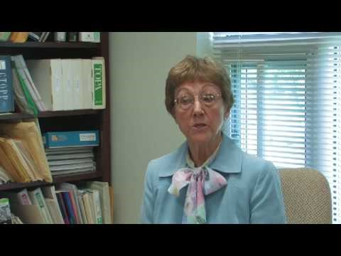
Who is qualified to diagnose dyslexia? What is the role of the teacher?

Slide 40
1.Monitoring of progress
The first step in identifying that children may have language learning difficulties, including dyslexia, is to notice those making poor progress in comparison with their typically developing peers, despite receiving high quality literacy teaching.
Where literacy difficulties are identified, responses should always take into account the quality of the teaching received by the child.
This is because children’s reading difficulties may result from the nature of the teaching rather than from inherent learning difficulties, though some children will have difficulties arising from both.

Slide 41
1.Monitoring of progress/2
Phonological awareness and rapid naming are the most implicated factors in the significant differences of reading skills.
Teachers notice individual differences and adjust their teaching. In Early Years, this can entail monitoring of children’s responses to the content in Letters and Sounds (sound discrimination, rhythm and rhyme, alliteration, oral blending and segmenting) for example.
It is important to ensure that a child’s hearing and vision have been checked, and that the possibility of any unidentified learning disability is considered.
Classes/age groups can be screened through standardized reading and spelling tests to identify those who struggle with literacy.

Slide 42
2-Skills assessment
Curriculum-based assessment establishes a clear starting point for a teaching approach that is systematic and repetitive (particularly in relation to phonics) and also takes account of language comprehension processes in literacy learning.
Skills assessment examines the child’s approaches to learning, e.g. how fluent/effortful it is to recall letters and words, how many repetitions seem to be required before new learning is retained.
Weaknesses in phonological processing and memory can be assessed or inferred from these observations and supplementary tests of these skills.

Slide 43
3.Comprehensive assessment
The school decides to seek outside advice and help from specialist teachers and educational psychologists and from other professionals as necessary, such as speech and occupational therapists.
Parents’ views are sought and they are kept fully informed throughout the process. All the information gathered so far forms part of a comprehensive appraisal of the nature and extent of the child’s difficulties.
The earlier dyslexic difficulties are identified, the better are the chances of putting children on the road to success.

Slide 44
Task 6
Check your information/day 1
Read the following statements and choose the correct answer:

Slide 45
Question 1
Choose the correct answer.
Learners with poor decoding and adequate comprehension skills are called:
a) poor comprehenders
b) dyslexics
c) fluent readers
d) low intelligent students

Slide 46
Question 2
Mark all correct answers.
Which of these are NOT found among causes of dyslexia?
a) individual learner differences, including personality or motivation
b) poor phonological processing
c) instructional methods
d) socio-economic factors

Slide 47
Question 3
Choose the correct answer:
Which of these statements rightly characterizes dyslexia?
a) When a young learner writes letters and words backwards, it means he/she has dyslexia.
b) A highly intelligent student with dyslexia can have a low reading score.
c) Dyslexia is a medical condition that can be cured.
d) Dyslexia is a learning difference/difficulty that one can grow out of.

Slide 48
Question 4
Choose the correct answer:
Which of these may help learners with dyslexia learn better in the classroom?
a) systematic and explicit teaching
b) techniques involving all senses
c) work assignments that are appropriately modified
d) all of the above

Slide 49
Question 5
Choose the correct answer:
Which of these is NOT a characteristic of dyslexia?
a) slow reading speed
b) problems with grapheme-phoneme correspondences
c) fast word retrieval
d) problems in keeping verbal material in phonological short-term memory

Slide 50
Question 6
Choose the correct answer:
Which of the statements is TRUE?
1) Smart people cannot have dyslexia
2) If a child finds learning to read and spell challenging, he/she has dyslexia
a) only 1)
b) only 2)
c) neither 1) nor 2)
d) both 1) and 2)

Slide 51
Question 7
Choose the correct answer.
Which of the following statements is TRUE?
a) Dyslexia is a visual perception problem.
b) Children grow out of dyslexia.
c) Dyslexia is a reading difficulty specific to the English language.
d) Dyslexia is neurological in origin.

Slide 52
Question 8
Mark all the correct answers.
What are the non-linguistic problems experienced by individuals with dyslexia?
a) smaller span of working memory
b) difficulties with handwriting
c) problems in word recognition
d) difficulties in time-management and organizing work

Slide 53
Question 9
Mark all the correct answers.
Word-reading difficulties can be the result of ………………………………………………………
a) phonological perception problems
b) low intelligence
c) lack of alphabetic knowledge
d) poor knowledge of grapheme-phoneme relations

Slide 54
Question 10
Choose the correct answer.
Dyslexia is caused by……………………………………………….
a) phonological processing difficulties
b) visual processing difficulties
c) inappropriate teaching
d) parental negligence

Slide 55


