Slide 1


State of Kuwait ELT Supervision
Ministry of Education Private Education
Scholastic Year: 2022-2023
Professional Development Program
Class Management Techniques
ELT Supervisor : Mrs. Hanan Al-Kafrawy
ELT Acting Senior Supervisor: Mrs. Wafaa Al-Jeraiwi

Slide 2
Workshop Objectives:
To know the definition of classroom management.
To learn practical techniques for managing learners positively.
To know some examples of disruptive behaviours and how to deal with them.

Slide 3
Effective classroom management is necessary for all teachers and facilitators. Classroom management involves all aspects of what is going on in the classroom while a lesson is being taught. Not only does class management include how the teacher delivers the curriculum, but also how the students interact with the teacher and with others in the classroom, and extends to the classroom environment in which students learn as well.

Slide 4

Brainstorm
“Class Management”

Slide 5
Definition
Classroom management refers to the wide variety of skills and techniques that teachers use to keep students organized, orderly, focused, attentive, on task, and academically productive during a class.

Slide 6
It is an ongoing process of managing students’ behaviour.
It is a multi-factor process.

Slide 7
What are the benefits of managing the classroom well?
Learners learn best in a safe and secure environment.
2. It saves time and effort for the teacher.
3. It is easier to engage students and get them on task.

Slide 8
Techniques of Achieving
Good Class Management

Slide 9
Positive class atmosphere
Body language
Classroom setting
Techniques
of Class Management
Setting rules
T-S Rapport
Offer praise
& incentives
Learner involvement
in activities
Frontal teaching x
group dynamics
Good lesson plan &
Those few minutes left
Control class energy

Slide 10
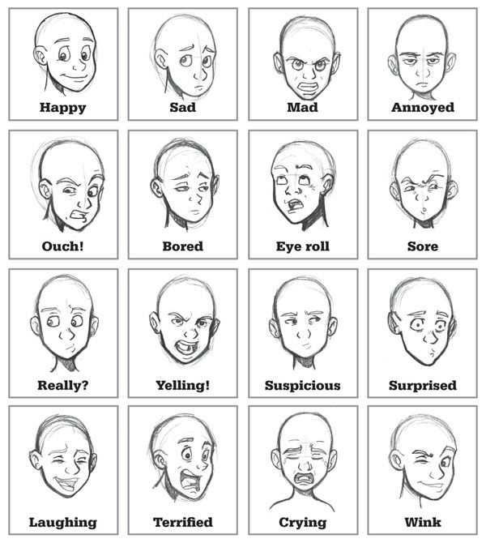
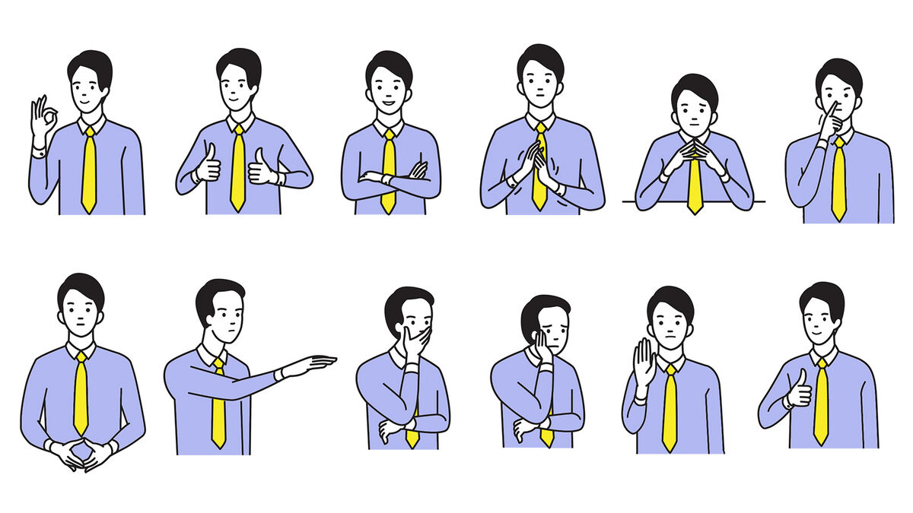
1- Body language & physical proximity:
Non verbal communication can sometimes do miracles .
Use facial expressions
Use hand gestures, and body motion
Use audible voice
Vary your voice tone
Vary the speed of your speech
Keep eye contact
Get into their space to give aid

Slide 11
2- Setting rules & routines:
Teachers need to establish some class rules of discipline.
Power Teaching Classroom Rules:
1- Follow directions quickly
2- Raise your hand for permission to speak
3- Raise your hand for permission to leave your seat
4- Make smart choices
5- Keep your dear teacher happy
Teachers set routines for collecting homework, distributing worksheets, checking attendance ...etc.
Maintain the students’ dignity and self- esteem and encourage them to be responsible for their own behaviour.

Slide 12

  3- Offer praise and give incentives
Praising learners or giving them incentives when they do good things means that you expect them to do this behavior more and more.
When ss. misbehave use verbal punishment with words of disappointment that lead them to behave well in the future. Avoid using physical punishment.

Slide 13

4 - A good lesson plan:
Planning a lesson which is suitable to the level , interests , learning styles and age group of learners can save time , effort and guarantee learning .
Those few minutes left:
Teacher must always be prepared with some extra activities (extension) that reinforce a certain skill on one hand and keep learners busy on the other hand.
Good time management
Transition time
  Decrease transition time.

Slide 14
5- Control class energy
Teachers use energizers ( stirrers ) and settlers to keep control over the learners and achieve good class management.
To activate learners, teachers play energetic games with them , then the teacher calm learners down by using settling activities like telling a story , listening to a song , drawing or writing activities.

Slide 15
  6- Frontal teaching x group dynamics:
Frontal teaching group dynamics
Teacher Teacher Teacher Teacher
The frontal teaching occurs when the teacher addresses the whole group ,who respond in union or one by one. The time involved in active communication is limited . It is perhaps an attractive method for teachers because discipline in the classroom is very easy and the students are so quiet.
Newer approaches to teaching languages make class activities much more communicative and efficient.

Slide 16
7- Learner’s involvement in activities:
How can teachers increase learner’s involvement and participation?
a. Arrange the seating of learners in a way that enables p ∕ p interaction.
b. Give effective, clear instructions.
c. Relate material to students’ lives, experiences and current events.
d. Pace of instruction is best if it is fast.
e. Engage students in group work and role playing as misbehaviour happens because students find “acting out “ more interesting than a boring lesson.

Slide 17
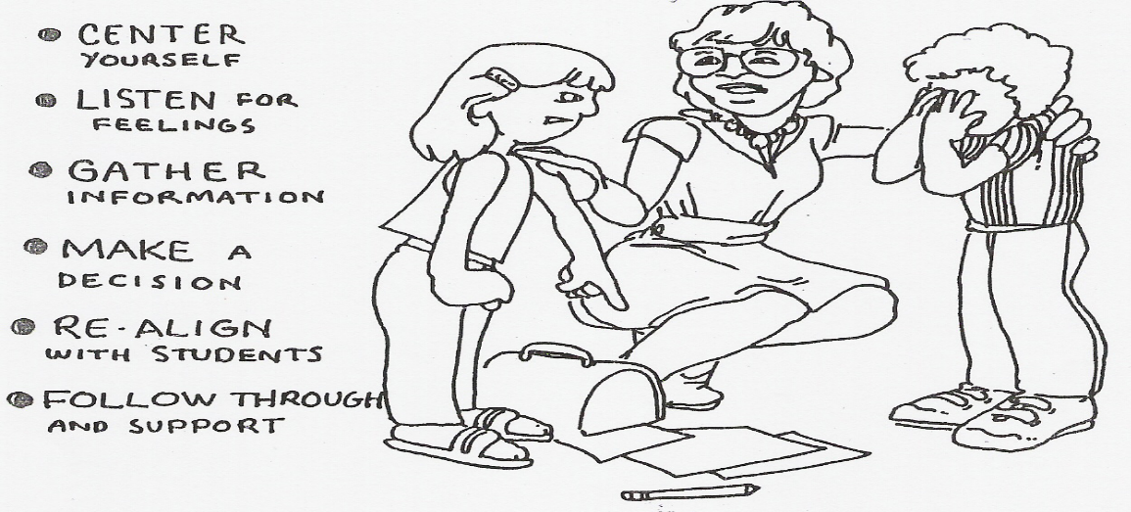
8- Teacher-Student Rapport:
Some teachers tend to create a strong bond with their students on the expense of class control while others do exactly the opposite. Teachers need to be patient , understanding, helpful, However , they should be strict enough, firm , and set rules and regulations that have consequences if they are violated. Sarcasm and humiliation are to be avoided .

Slide 18
Some Tips for Rapport-Building
Call your students by name.
Repeat and paraphrase student’s answers. This shows that you were attentively listening.
3. Use eye contact, non-verbal cues such as a nod, and facial expressions to indicate that you're interested.
4. Reward students with verbal praise.

Slide 19
More Tips for Rapport-Building
5. If you are not sure of what a student is asking about, ask some questions which will help you clarify. Don't say,
"I don't understand what you mean.“
6. Let students know you care about them by attending an outside class activity that they are in, like sporting events, a play , ..etc.

Slide 20
9- Classroom Setting:
Arrangement of Seating :
The choice of seating depends on the number of class members, activities to be tackled and level of learners.
shape shape in rows
b. Classroom Decoration:
Decorating classroom walls with posters and magazines is so beneficial.
c. Classroom lightening and ventilation.

Slide 21
10- Creating a positive class atmosphere
Maintain a safe and secure class atmosphere.
Use games and attractive activities.
Relate activities to pupils’ interests and needs .
Show learners your care , interest , support and love.
Minimize fear and stress.
Set high expectations of all your students.

Slide 22
Classify the following factors into factors which you can control or improve, and those which you can’t control:
1- Classroom layout 8- Fairness
2- Learners’ natural abilities 9- Outside noise
3- Lesson content 10- Mutual respect
4- Motivation 11- Classroom rules
5- Previous experience 12- Group dynamics
6- Classroom size, furniture 13- Time of lesson
7- Involving learners in activities
Task

Slide 23
Good classroom management is also
an important factor related to dealing with disruptive behaviour
effectively.

Slide 24
Examples of disruptive behaviours
Suggested remedy | Explanation | Behaviour
Give him one private warning. Hold a private meeting with the student, discuss alternatives to gain class attention. | Acting like a clown to attract attention | Clowning
Offer help to the student, show a caring attitude. Look for possible reasons for his misbehaviour ,he might be having troubles or some kind of disabilities. Offer encouragement for efforts made | Refusing to attempt a written assignment | Refusals
Show care and passion. Praise acceptable behaviour and ignore unacceptable ones. Assign responsibilities that use his hyperactivity. | Moving all the time ,not being able to concentrate nor pay attention | Hyperactivity

Slide 25
Project
Mention a problem that might face you in the classroom and suggest possible class management strategies that can be used to solve this problem.

Slide 26
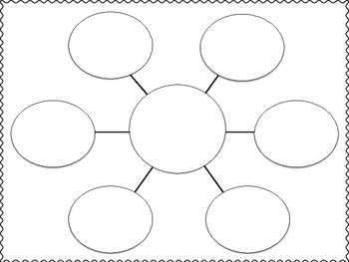
Project
Mention a problem that might face you in the classroom
and suggest possible class management
strategies that can be used to solve this problem.

Slide 27
References:
1. https://www.edglossary.org/classroom-management/
2. Classroom Management: Strategies for Teaching
Edited by Orion Gutierrez , College Publishing House, Copyright © 2017
3. Class Management, Pcc , copyright 2004
4. Classroom Management Strategies
Resource Guide © 2014, Prevention First
5. Classroom Management, Brian Warnick, Certificate in Effective Instruction,
Association of College and University Educators, 2021
6. https://www.youtube.com/watch?v=sEQKFmBfBcU&t=1415s

Slide 28
Post Assessment
https://forms.office.com/r/JNCTRpytnk

Slide 29

Thank you
&
Wishing you a fruitful year .

