Slide 1

Using elicitation in teaching language skills
ELT supervision
Private Education
Professional Development Programme
2022/2023

Slide 2
Main points
1. Teacher talk and student talk
2. Definition of elicitation
3. Advantages and considerations
4. Stages of effective eliciting
5. Types & examples of elicitation techniques
6. How to plan and evaluate the elicitation techniques?
7. Recommendations for using elicitation techniques

Slide 3
1.Teacher talk & student talk

Slide 4
Teacher talk & student talk
The balance between teacher talking time (TTT) and student talking time (STT) depends on the activities, the type of the lesson and the level of students.
Teachers tend to speak more when:
Presenting, clarifying, checking and modelling new language.
Setting up new activities or giving instructions.
Providing language input as telling a story.
Establishing rapport by chatting

Slide 5
The advantages of teacher talk
The teacher is a source of authentic language.
Teacher talk is needed for classroom management.
You can present models of a new language (vocabulary or grammar).
Explaining something about the language in a reassuring way.
But if you talk too much:
Students don’t have the chance to participate.
You won’t be able to listen closely enough to your students.
For lower levels, the language used in explanation may be difficult.

Slide 6
How can you help students understand what you say?
Grade your language and adapt the way you speak to the level of your students.
Think about the speed of delivery especially when you are delivering a model of target language.
Choose your language carefully and consider learners’ background.
Give your students enough time to do what you ask them to do.
Avoid technical terms such as: “concept checking”, “ Eliciting”…etc.
Don’t use words when a gesture or a picture can convey the message quickly and clearly.

Slide 7
2. What is elicitation?

Slide 8

Task 1
Watch the video and note what the teacher is doing
https://www.youtube.com/watch?v=25G_MSpnFNI

Slide 9
Elicitation/1
Elicitation is term which describes a range of techniques which enable the teacher to get learners to provide information rather than giving it to them.
Commonly, eliciting is used to ask learners to come up with vocabulary and language forms and rules, and to brainstorm a topic at the start of a skills lesson.
In the Dictionary of Language Teaching and Applied Linguistics, eliciting means: ‘Techniques or procedures which a teacher uses to get learners to actively produce speech or writing‘.

Slide 10
Elicitation/2
Elicitation is a technique used by the teacher to elicit students’ responses and to stimulate students to talk in the classroom.
Darn (2008) states that elicitation is a preferable method that helps promote students’ involvement in the lesson and develops a learner-centered classroom.
Through the elicitation technique, the time for students to speak or the students talking time (TTT) in the classroom increases automatically, and the time for the teacher to speak or the teacher talking time (TTT) decreases.

Slide 11
Elicitation/3
Elicitation is a technique used by the teacher to get information about what students already know and need to know.
Elicitation is also used to measure/check students’ understanding of the material given by the teacher.
Elicitation involves asking questions and extending students’ answers and responses.

Slide 12
3. Advantages and considerations

Slide 13
Advantages of elicitation techniques
1. Students are focused during elicitation: when teachers ask different
types of questions to the learners, they are focused and try to participate actively in class so the environment becomes dynamic and stimulant.
2. Eliciting shows what students already know and makes learning memorable as learners can link new and old information. By starting with easy questions and working towards more difficult ones, you will be able to boost their confidence .
3. Learners take a more active role in the learning process by bringing their life experiences and knowledge of the language into the classroom.

Slide 14
Advantages of elicitation techniques/2
4. Elicitation shows teachers if the students are listening and grasping information.
5. During elicitation, there is more student talking time (STT) rather than teacher talking time (TTT).
6. Students learn to guess during elicitation. They are encouraged to try, even if they can only answer partially.
7. Students are exposed to useful incidental language during elicitation.

Slide 15
Considerations when using elicitation techniques
1. Encourage rather than correct. When eliciting language, comments such as ‘nearly right' and ‘try again' are more constructive than ‘no, does anyone else know the right answer?‘
2. Eliciting may be met by silence when students don’t know the answer, it means they need more language input.
3. One or two students may dominate the task and answer everything.
4. Some teachers are not well-trained to use elicitation techniques.

Slide 16
4. Stages of effective elicitation

Slide 17
Stages of effective eliciting
Convey: The teacher conveys a clear idea to the students using a variety of techniques using pictures, gestures or questions, …etc.
Supply: The teacher the appropriate language , information or ideas with drilling and allowing students to practice.
Feedback: The teacher use concept-checking techniques to ensure students have understood the meaning.
Board: The teacher provides a written model on the board for students to copy and have a written record in their notes.

Slide 18
5. Types & examples of elicitation techniques

Slide 19
Types of elicitation techniques
1.Asking questions
2. Asking questions combined with pictures
3. Asking questions combined with non-verbal language

Slide 20
1.Asking questions
1. Eliciting can take place in any stage of the lesson by asking questions. It is an important tool to manage the class.
2. The teacher asks simple questions about the topic and elicits answers from students. Checking students’ understanding with simple questions.
3. Then, the teacher models the target language and asks students to make drills either individually or in groups.

Slide 21

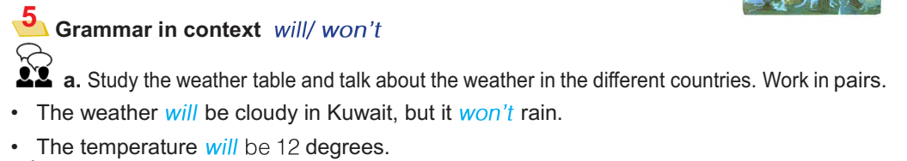
Grade 7 P78 U12 /Grammar

Slide 22
A situational dialogue, example sentences or a listening/reading text may provide the context from which the target language is elicited. In this case, the teacher is asking the learners to notice how a particular function is expressed, and eliciting is combined with concept questions. In a text or dialogue about the future:

Slide 23
A situational dialogue:
T: Is he talking about the past, present, or future?
S: Future
T: Does he know / is he sure about the future?
S: No
T: Right. It's a prediction. What verb does he use?
S: Will
T: Good. Can you give me an example?
S: The weather will be rainy tomorrow.

Slide 24
2. Asking questions combined with pictures
By using a picture from the textbook or another source, they can build students’ interest and stimulate their curiosity and imagination.
The teacher can set the scene and ask questions “ What can students see?” “Why they think it happens?” “What they think will happen first?” “ How they feel about it?”
So, the picture is a medium to activate students’ thinking or imagination about the topic.

Slide 25

Book 7 unit 6 p. 39 / Reading

Slide 26
2. Asking questions combined with pictures
T: Look at this picture, what can you see?
S: Kuwaiti flag, fireworks, Kuwait Towers.
T: Great! How do you feel?
S: Very proud.
T: When do we have fireworks?
S: In celebrations.
T: Like.
S: Eid El-Fitr, Hala February, Eid Al-Adha, National Day

Slide 27
3. Asking questions combined with non-verbal language
Non-verbal language is attractive in encouraging students’ participation. Non-verbal language such as mimicry, gesture, facial expression, body language can be alternated to make students active in the classroom
Non-verbal language is used mainly to elicit new vocabulary and structure. Because, in using non-verbal language the teacher does not give the question with his or her voice, but
with their body language, mimicry, gesture, facial expression.

Slide 28
Watch the video and write down how the teacher elicits vocabulary
https://www.youtube.com/watch?v=RR_JJWuZbzs

Slide 29
Task 2
Look at the writing task and prepare a dialogue trying to generate ideas from students about the topic.

Slide 30
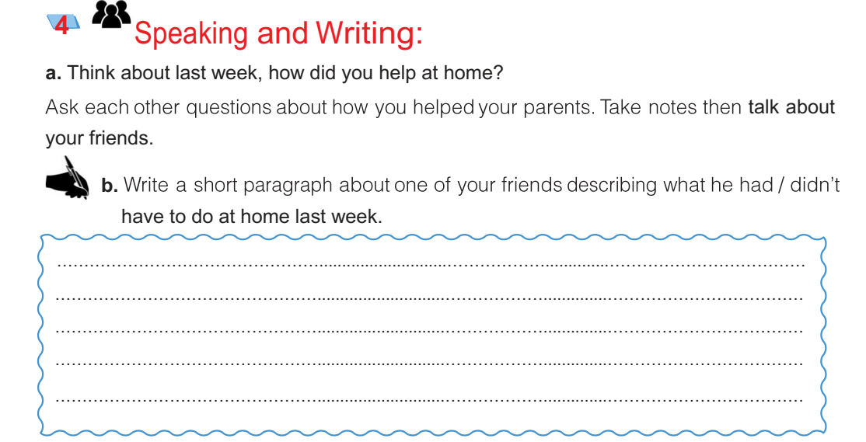
Grade 7 p 60 SB

Slide 31
Task 3
Look at the grammar rule and prepare a dialogue trying to elicit the use of who / which

Slide 32
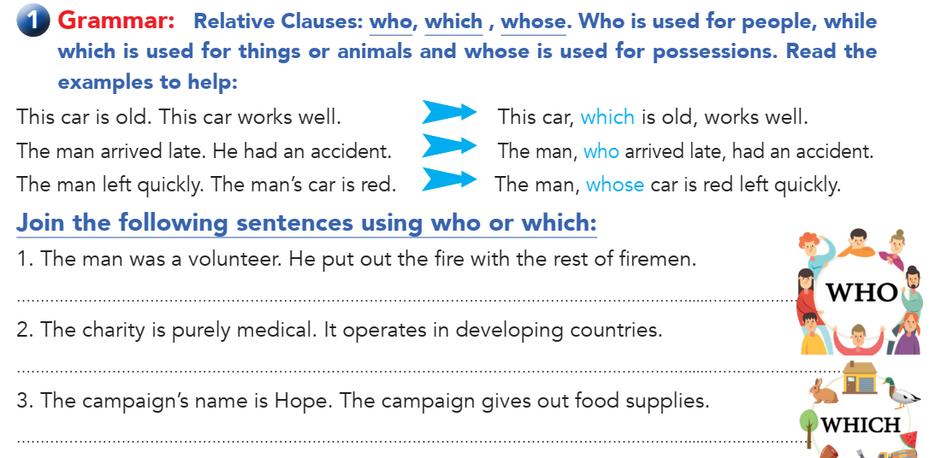
Book 9 p 30/ Grammar

Slide 33
7.How to plan and evaluate the elicitation techniques?

Slide 34
How to plan your elicitation techniques
Consider your next lesson and the specific factual information you are going to teach or revise.
What are the questions could you ask to interest at the beginning of the lesson in order to interest your learners?
Write a sequence of questions that you could use to lead students step by step towards finding the same information by themselves.
You can try out this sequence of questions with a colleague beforehand.

Slide 35
How to evaluate the elicitation techniques?
Did the teacher use a variety of techniques?
Did learners understand your questions?
Did the teacher use visual clues?
Were all the students participating?
How many students were called on to contribute?
Were your questions concise and clear?

Slide 36
6.Recommendations for using elicitation techniques

Slide 37
Recommendations for using elicitation techniques/1
Eliciting is a basic technique and should be used regularly, not only at the beginning of a lesson but whenever it is necessary and appropriate.
Don't try to ‘pull teeth'. Prolonged silence or incorrect answers suggest that input is required from the teacher.
Don't ask students to repeat incorrect answers, but ask a variety of students to repeat a good answer.
Acknowledge or give feedback to each answer with gestures or short comments.

Slide 38
Recommendations for using elicitation techniques/2
Provide sufficient context or information. Eliciting is designed to find out what the learners know rather than to lead them to a conclusion that only the teacher knows.
Learners can elicit from each other, particularly during brainstorming activities. This helps to build confidence and group cohesion as well as shifting the focus away from the teacher.
At lower levels, more guided questioning is needed. Open-ended questions should be avoided as the learners are unlikely to have the language to answer them to their own satisfaction.

Slide 39
More examples of elicitation techniques
Write down how to start eliciting in each of the following activities:

Slide 40
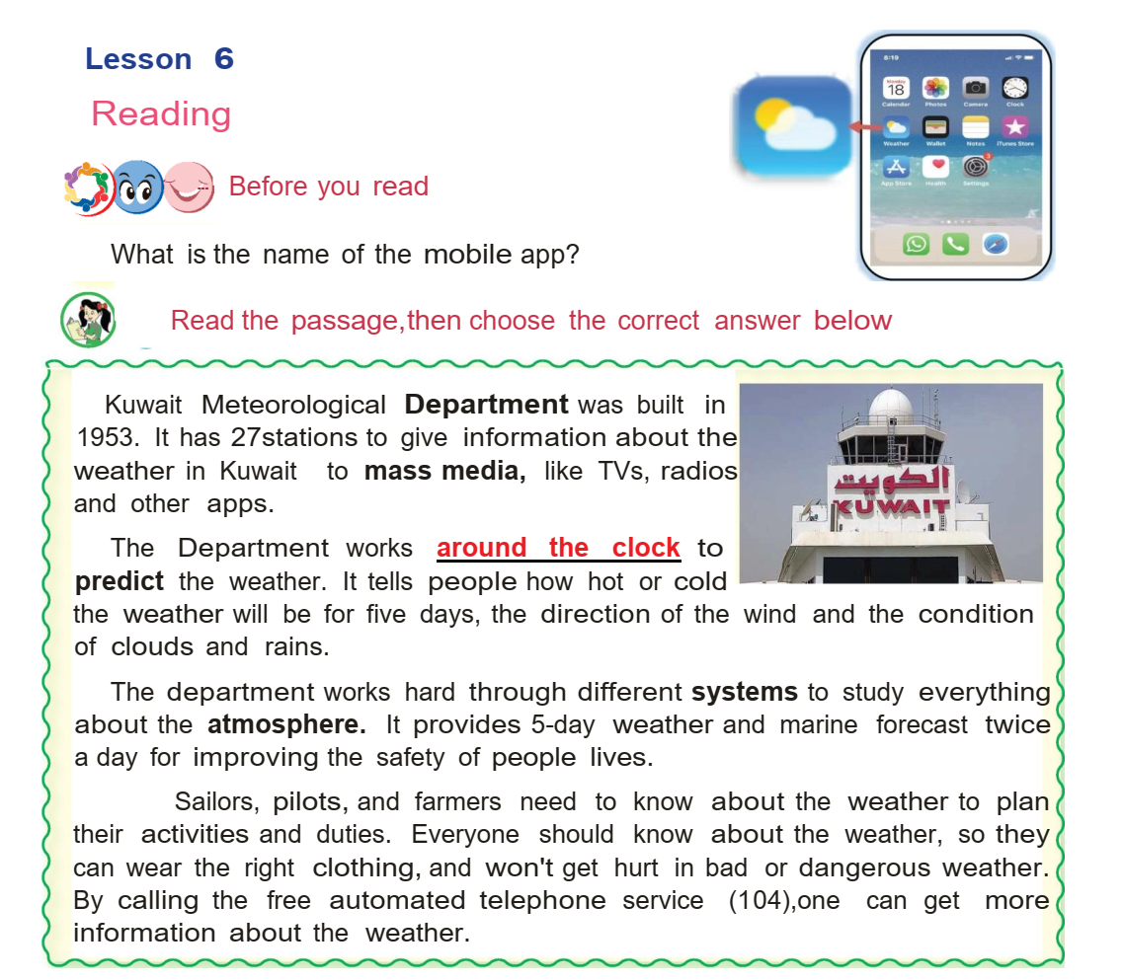
Book 5 p 46 / Reading

Slide 41
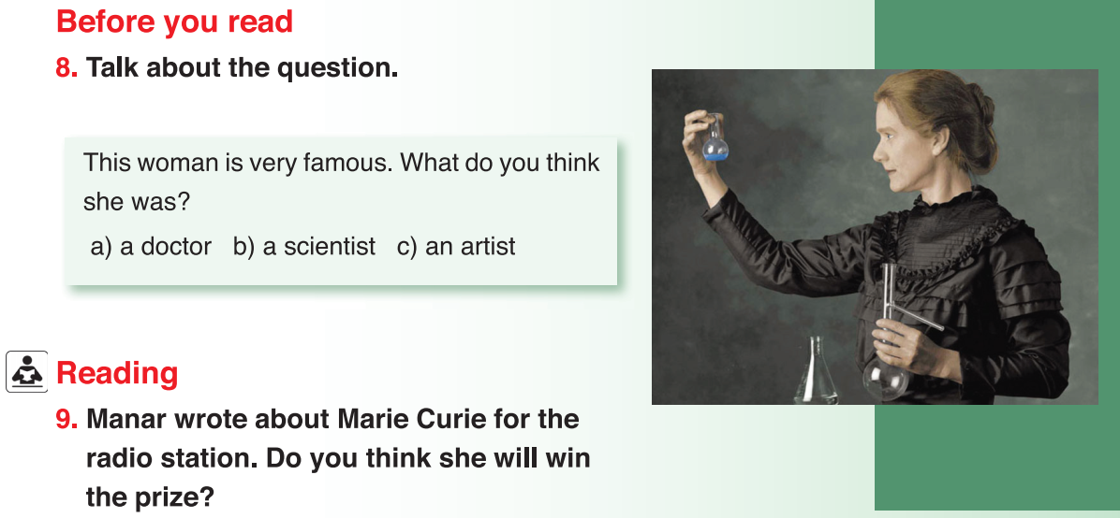
Book 6 p 73 / reading

Slide 42
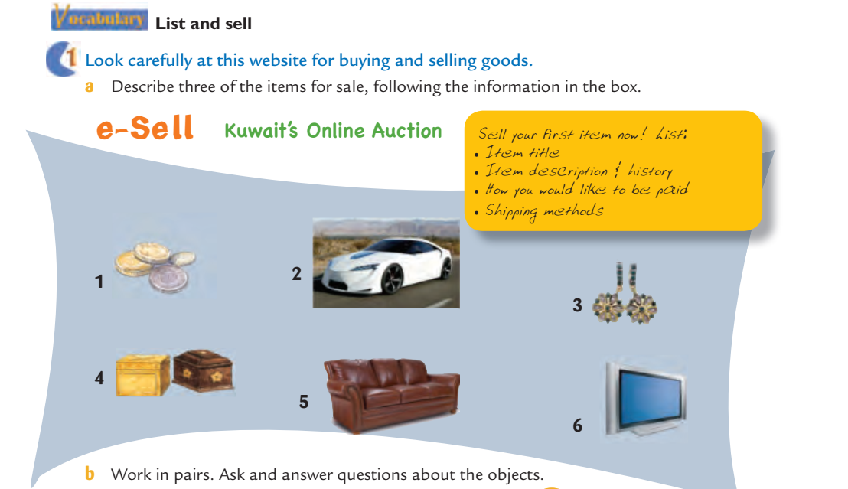
Book 10 p 71 / vocabulary

Slide 43


